Slide 1
Priorities for managing sick newborns using IMNCI:
Experiences from Lao PDR

Slide 2
The problem
Under 5 mortality is improving
So is neonatal mortality
…but not as fast

Slide 3
The problem
Over time neonatal deaths account for a greater proportion of child deaths.
If we are going to continue to improve child deaths, we must improve infant and newborn mortality

Slide 4
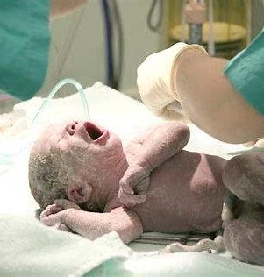
Neonatal death
Neonatal death make up an increasing proportion of child deaths and require specific action
EENC focuses on;
Essential interventions at delivery
KMC
But once unwell or when presenting sick from home IMNCI is essential
IMNCI for outpatients
WHO Pocketbook of Hospital Care for inpatients
Notes:
Worth mentioning that there has been a large investment and focus on EENC. But for the sick and preterm newborns there has been little focus. Some hospitals had been targeted through Pocketbook training, some through specific donors (eg Lao-Swiss) but large gaps.

Slide 5
How can IMNCI help?
During IMNCI and Pocketbook implementation many health facilities describe cases where care could be improved
For example
Early discharge after delivery limiting monitoring
Sick infants or neonates transferred from health centre without pre-referral antibiotics
Sick infants or neonates with fever and seizure being treated for seizure but not the fever
Inability to refer sick neonates to provincial hospitals due to transport cost or family barriers
Provision of equipment to district hospitals without training in how to use equipment or how to treat the child
Lack or cost of oxygen
Notes:
Some of these require investment in equipment, most require us to train staff better and all of the resources are available in IMNCI and Pocketbook training modules

Slide 6
How can IMNCI help?
In the pilot of the new IMNCI coaching approach we found simple strategies can help:
Many health workers (who had trained in IMCI before) could not calculate drug dose by weight
Practice drills with calculations improve confidence and use
Danger signs are not routinely documented and it is not clear if they are recognised
Audit of log books & feedback on what is important helps change practice

Slide 7
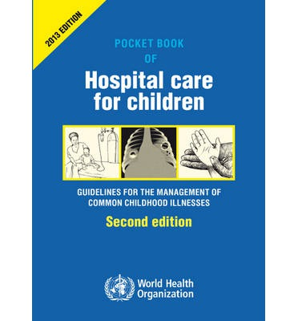
How can IMNCI help?
In the implementation of WHO Pocketbook in Luang Prabang province at district hospitals many district hospital staff told us they could not always transfer sick or LBW newborns to the province, so they go home sick.
Through training we built capacity
To give NG feeds at the district
To treat sepsis, low glucose and seizures
Now we hear stories of sick newborns with these problems
They are fed, kept warm, given simple antibiotics, glucose
…and survive

Slide 8
The message
Simple treatments can make a large difference to the care of sick newborns.
We have many of the tools we already need.
Consistency is important (the same messages from IMNCI, Pocketbook, etc.)

Slide 9
What have other countries done?
Minimal standards for neonatal care in district hospitals in PNG lowered the neonatal mortality rate by 44%
10 principles (8 of which are simple)
Treating apnoea
Keeping babies warm
Recognising and treating hypoglycaemia
Safe use of IV fluid
Appropriate antibiotic use
Infection control
Auditing of practice
(Giving oxygen and training nurses)

Slide 10
What have other countries done?
Uganda – Two-staged introduction of standards
Level 1:
Monthly audit and review of neonatal data
Guidelines
Training in recognition and immediate treatment of danger signs/sepsis
Training in medication, neonatal feeds and IV fluid administration
Kangaroo Care
Improved infection control
Neonatal mortality reduced from 48% to 40%
Level 2
For specific neonatal unit (equipment and specific staff)
Neonatal mortality reduced from 40 to 21%

Slide 11
What is the benefit of minimum standards
Minimum standards set a level against which you can
Measure practice
Provide feedback
Show improvement
You are not “aiming high”. You are saying everyone should be able to reach this standard.

Slide 12
Possible minimal standards; health centres
Danger signs are checked and recognised in every neonate
All sick neonates receive pre-referral antibiotics
Glucose is given to babies with seizures or coma
Referral is made without delay
All pre-referral treatment for danger signs must be available at HC

Slide 13
Possible minimal standards; district hospitals
Treat any neonate with “danger signs” or “signs of serious bacterial infection” with appropriate antibiotics
Give oxygen to any baby with SpO2 < 90% or clinical signs of hypoxaemia
Keep babies warm (KMC)
Detect and treat hypoglycaemia
Provide NG feeds if needed (and understand safe use of IV fluid)
Provide treatment to prevent apnoea in preterm babies

Slide 14
What more might be needed?
Equipment
O2 prongs and concentrators
Phototherapy
Training
Nursing care for sick newborns
Audit and review of practice
Appropriate space
To care for sick neonates (eg easy to observe, warm)
To provide feedback

Slide 15
Other questions
What should we expect health centres and hospitals to do if referral is not possible?
What (if anything is needed) provincial and central hospitals?

Slide 16
Possible strategies for discussion
Sick newborn module using new IMNCI approach is currently being developed
For health centres
Sick newborn and LBW module for Pocketbook already available
For district hospitals
Currently being rolled out in a “bundle” with rest of Pocketbook training
Option is to focus on Sick Newborn module in more hospitals
Need to ensure it is aligned to other standards (Essential Medicines, Facility standards for equipment and services)
Could be done as research/evaluation to demonstrate impact on mortality

