Slide 1
Case presentation
Phengsy Sengmany, MD.
LuangNamTha Provincial Hospital
April 2019

Slide 2
General information
A 7 day-old Hmong boy from LuangNamTha District.
Admission: 27/11/2018 at 14:00.
Chief complaint: fever for 3 days and unable to suck
History of Present illness:
3 days PTA, fever and pale
2 days PTA, lethargy, irritable, crying a lot and poor sucking
1 day PTA, decreased consciousness, muscle spasm, seizure, spastic limbs and no breast feeding.

Slide 3
Past medical history
1st child in the family
GA: term (no exact GA)
No ANC, no PROM, no maternal fever before and during delivery
Born at home and used unsterile knife to cut umbilical cord
No complication after delivery
No vaccination
Teenage parents

Slide 4
Physical examination
GA: inactive, Lethargy, irritable, no sucking
VS: T: 38.5c, HR: 120 bpm, RR: 64bpm,
Spo2: 93% (room air)
BW: 3,230 g; Length: 52cm.
HEENT: pale conjunctivae, AF: no bulging
RS: no cyanosis , grunting, intercostal retraction, suprasternal retraction,
wet lung sounds.

Slide 5
Physical exam(cont.)
CV: no tachycardia, no murmur
GI: mild abdominal distention, mild tenderness, impalpable liver and spleen.
Umbilical redness, discharge and bad smell
GU: Normal
Ext: warm, no edema.
Skin: pale, no rash, no petechiae
Neuro-signs: drowsiness, irritable, crying a lot, muscle spasm, hypertonicity and generalized seizure.

Slide 6
Positive finding
Fever, pale, mild abdominal distention
Umbilical discharge
Respiratory distress
Drowsiness, irritable, spasm, hypertonicity
Seizure
No sucking

Slide 7
Any question or comment?
Your comment?
Your experience?

Slide 8
1st Diagnosis
Late onset sepsis
Umbilical infection
Severe pneumonia
Meningitis

Slide 9
Lab. shown 27/11/2018
CBC | Result | Reference
WBC | 10.9 | 6.0-10.0
Lym | 9.8 | 20-40
Gran | 87.8 | 45-70
HGB | 12.1 | 12-16
RBC | 4.21 | 3.80-50
HCT | 27.3 | 37-45
MCV | 100 | 80-95
MCH | 33.1 | 26-36
MCHC | 37.7 | 32-36
RDW | 15.4 | 11-16
PLT | 508 | 150-300
Glucose | 122 | 70-110
Eleetroly | Result | Reference
K | 5.87 | 3.48-5.50
Na | 134.47 | 135.37-145
CL | 99.63 | 96-106
Ca | 4.08 | 4.40-5.40
pH | 7.35 | 7.35-7.45

Slide 10
Treatment
1st day (27/11/18)
Ampicillin 150 MKDay
Gentamycin 5 MKDay
D5W1/2NSS 10ml/h
Oxygen cannel
Breast milk via OG

Slide 11
Progression
28/11/2018:
Fever, pale
Lockjaw, unable to suck
Generalized seizure when handling, muscle spasm, hypertonia
Opisthotonus
Diagnosis: Tetanus

Slide 12
Progression
02/12/2018
Fever
Lock jaw
Difficulty swallowing
Generalized seizure
Muscle spasm
Opisthotonus.
Edema
BW=4,400g

Slide 13
Lab 2/12/2018
CBC | Result | Reference
WBC | 11.00 | 6.0-8.0
Lym | 10 | 20-40
Gran | 87.00 | 45-70
HGB | 12.1 | 12-16
RBC | 4.21 | 3.80-50
HCT | 37.3 | 37-45
MCV | 75 | 80-95
MCH | 32.1 | 26-36
MCHC | 37.9 | 32-36
RDW | 15.4 | 11-16
PLT | 298 | 150-300
Glucose | 100 | 70-110
Eleetroly | Result | Reference
K | 5.9 | 3.48-5.50
Na | 130.47 | 135.37-145
CL | 97.63 | 96-106
Ca | 4.00 | 4.40-5.40
pH | 7.37 | 7.35-7.45

Slide 14
Treatment
SAT (Serum Tetanus antitoxin (TAT) 10.000ui + D5W 100ml continue
Tetavax vaccine –IM
Valium 10mg+ D5W continue >>>> off days 12
Phenobarbital 5 MKDay >>>> off days 19
Clean umbilical cord tripho
Lasix 20mg (1MKD) >>>off days 3
Discontinue ampicillin and gentamycin
Penicillin 400,000ui/kg/day for days 14
NPO for 7 days. Then started Oral feeding days 20

Slide 15
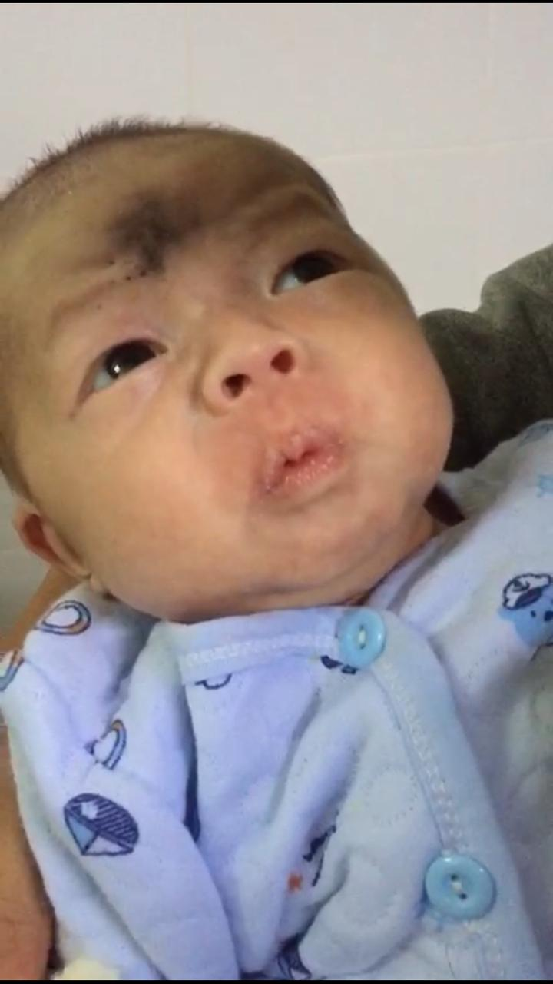
The patient before discharge from the hospital
Progression:
Mild muscle spasm
Hypertonia
Sucking well
No seizure
Discharged: 24/12/18

Slide 16
Final Diagnosis
Neonatal Tetanus

Slide 17
Discussion point
ANC program
Home delivery versus hospital delivery
Umbilical cord care
Diagnosis and management (late?)
Treatment (Tetanus antitoxin and Tetavax ) ATB, anti spastic or anticonvulsive drug

Slide 18
Thank you for your attention

