Slide 1
Sick Day Management and DKA
Amphayvanh Manivong, M.D.
Pediatrician
Department of pediatrics General ward
Mahosot Hospital
Vientiane of Laos PDR

Slide 2
Overview
To learn how to manage insulin and carbohydrate intake during sick days
To learn how to manage hypoglycemia
To learn how to manage DKA

Slide 3
Further readings
ISPAD Clinical Practice Consensus Guidelines 2018
www.ispad.org

Slide 4
Balance
Insulin
Carbohydrate
Activities

Slide 5
Hyperglycemia
Insulin deficiency
Glucosuria
Polyuria and dehydration
Ketone production
Rx: More insulin and Adequate fluid

Slide 6
Hypoglycemia
Too much insulin
Inadequate carbohydrate intake
Exercise
Coexisting Addison disease???

Slide 7
Sick day management

Slide 8
During Sick Days
Hyperglycemia-During fever/↑Need for insulin
Hypoglycemia – Decreased food intake/vomiting/diarrhea/ ↓Need for insulin
When vomiting occurs-Think of insulin deficiency until proven otherwise

Slide 9
During Sick Days
Target BS 70-180 mg/dL
Blood ketone is less then 0.6 mmol/L

Slide 10
During Sick Days
Blood sugar should be checked every 2-4 hours
Check urine ketone if BS ≥ 250 mg/dL
(Blood ketone check is preferred)

Slide 11
During Sick Days
Rest
Drink plenty of fluid: small amount but frequent
Do not stop insulin !!!!

Slide 12
Principle of Sick Days Management
Being able to eat or drink
Give additional 5-10% of TDD as or rapid-acting insulin q 2-4 hours (absent or small ketone)
If moderate or large ketones- Give 10-20% of TDD
Encourage sugar-free fluids
Being unable to eat and drink
Do not stop insulin !!!
Need hospitalization

Slide 13
During acute illness: high blood sugar with ketonuria
Calculation of increase insulin dose
5-10% of TDD or 0.05-0.1 U/kg
10-20% of TDD or 0.1-0.2 U/kg

Slide 14
During acute illness: Normoglycemia/Hypoglycemia
If being to able to eat and drink
Negative ketone or trace/small ketone
Oral sugar fluids and Extra CHO
If BS < 90 mg/dL , TDD insulin often needs to be decrease 10-20%

Slide 15
During acute illness: Normoglycemia/Hypoglycemia
If moderate /large ketone-
Do not reduce TDD insulin !!!
If BS is 90-180 mg/dL
Add 5% TDD or 0.05 U/kg to ordinary bolus
If unable to eat and drink
Give IV fluid with 5% glucose

Slide 16
When to be come to the hospital
Persistent vomiting
Labored breathing
Sever abdominal pain
Drowsiness or confusion
Persistently low or high blood sugar or large ketonuria or blood ketone > 1.5 mmol/L
Very young child or exhausted caregivers

Slide 17
Guideline for Treatment of DKA in children and adolescents
Details in:
ISPAD 2018 guideline

Slide 18
DKA: Biochemical criteria
Blood Sugar > 200 mg/dL
Ketonemia or ketonuria
Venous pH < 7.3 or
Bicarbonate <15 mmol/L

Slide 19
Risks of DKA
Younger age
Delayed diagnosis
Lower socioeconomic status
Insulin omission
Poor metabolic control
Puberty
Psychosocial issues
Difficult or unstable family

Slide 20
DKA: Goals of treatment
Correct dehydration
Correct acidosis
Reverse ketosis
Slowly correct hyperosmolality
Restore blood glucose to near normal
Monitor complications
Identify and treat precipitating event

Slide 21
Pathology of DKA
Absolute insulin deficiency
Stress, infection or insufficient insulin intake
Counter regulatory hormone
↑glucagon ↑cortisol
↑catecholamine ↑Growth Hormone
↑proteolysis
↓protein synthesis
↑lipolysis
↓Glucose utilization
↑Glycogenolysis
↑Gluconeogenic substrates
↑FFA to liver
↑Gluconeogenesis
↑ketogenesis
Hyperglycemia
↑Alkali reserve
Glucosuria (osmotic diuresis)
Acidosis
Loss of water and electrolytes
Decrease fluid intake
Hyperosmolarity
↑Intake
Dehydration
Impaired renal function

Slide 22
DKA: Clinical signs
Dehydration
Tachypnea
Deep, sighing (Kussmaul) respiration
Nausea, vomiting
Abdominal pain
Confusion, drowsiness, alteration of consciousness

Slide 24
Management of DKA
Confirm the diagnosis
Assess clinical severity of dehydration
Provide supportive measures
Closing monitoring

Slide 25
Initial Labs
Serum glucose
Serum and urine ketone
BUN, Cr, Electrolytes
Blood gas
Find precipitating factors
New cases: IA-2, anti-GAD

Slide 26
Severity of DKA
 | Venous pH | Bicarbonate (mmol/L)
Mild | < 7.3 | < 15
Moderate | < 7.2 | < 10
Sever | < 7.1 | < 5

Slide 27
Fluid management
Being fluid replacement before starting insulin therapy
Give NSS 10 mL/kg in one hours if not shock
Need individual adjustment

Slide 28
Fluid therapy
Correct fluid deficit evenly over 48 hours
The rate should not exceed twice maintenance
Use 0.45 to 0.9% saline

Slide 29
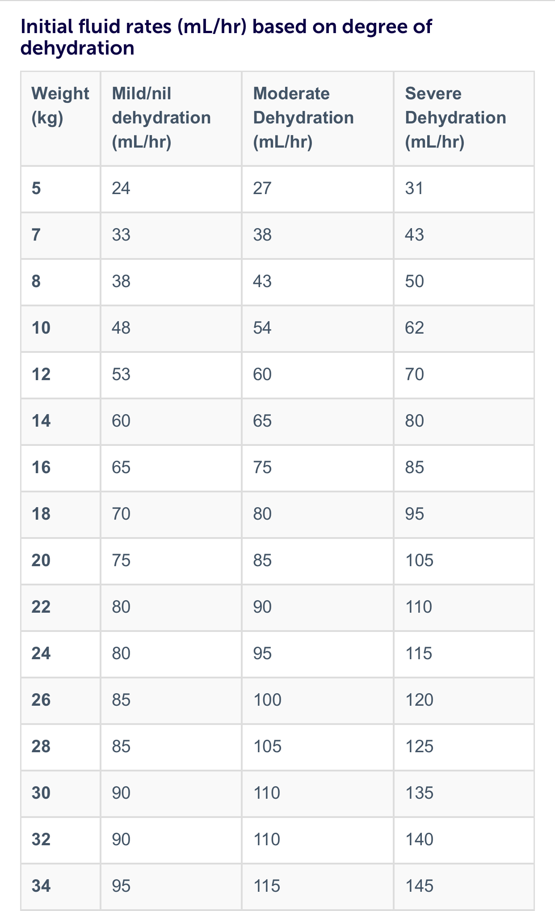
Fluid
Replacement

Slide 30
Insulin therapy
Begin with 0.1U/kg/hour
Start at least one hour after initial fluid therapy
IV insulin bolus-unnecessary
Continue insulin IV drip till resolution of DKA (pH>7.3, bicarbonate >15 mmol/L, BOHB< 1mmol/L or closure of anion gap)

Slide 31
Insulin therapy
5% glucose should be added when serum glucose falls to 250-300 mg/dL or blood glucose decrease faster then 100 mg/hr

Slide 32
Insulin drip preparation
Mix regular insulin 100 units
(1ml) in 0.9 Nacl 100 mL
(Concentration 1 mL = 1 unit)
Flush IV infusion set with the above IV 30mL

Slide 33
Potassium therapy
Total body K is deficient
Start K supplement when K ≤ 5.5 mEq/L and urine output is present
If serum K is low, start K at the time of initial volume expansion and before starting insulin Rx

Slide 34
Potassium therapy
Begin with 40 mmol/L
Forms: KCl and K phosphate
Max rate 0.5 mmol/kg/hr
Insulin Rx and correction of acidosis will drive K back to cells

Slide 35
Bicarbonate
HCO3 is not recommended unless the acidosis is profound and poor tissue perfusion are present

Slide 36
Closed monitoring
Vital signs and Neuro signs q 2 hours
Blood Sugar q 1 hour
Serum e’lytes, BUN, Cr, blood gas q 2-4 hours
I/O hourly
Blood or Urine ketone q 2-4 hours

Slide 37
Transition to oral fluid and SC insulin injection
Insulin drip can be discontinued when Acidosis is resolved (mild acidosis or ketone may still be present)
Oral intake is tolerated
Switch to SQ insulin before mealtime

Slide 38
Transition to oral fluid and SC insulin injection
Giving SQ insulin before discontinuation of IV insulin
Rapid-acting: 15-30 minutes
Regular insulin: 1-2 hours
The dose and types of SQ insulin should be according to local preferences and circumstances

Slide 39
Signs and symptoms: Hypoglycemia
Automatic: sweating, tremor, palpitation
Neuroglycopenic: poor concentration, blurred vision, slurred speech, confusion
Behavior changes: erratic behavior, nightmare, constant crying
Non-specific symptoms: headache, nausea, hunger, tiredness

Slide 40
Definition of Hypoglycemia
The aim of DM treatment should be to maintain blood sugar level 70 mg/dl
A glucose level of < 70mg/dl is used as a threshold value for initiating treatment is diabetes

Slide 41
Definition of Hypoglycemia
Clinical hypoglycemia alert: BG 70mg/dl
Clinical important or serious hypoglycemia: BS 54mg/dl
Sever hypoglycemia: the presence of sever cognitive impairment which required external assistance

Slide 42
If blood sugar ≤70mg/dl
Take quick-acting sugar (10-15g glucose) = 0,3g/kg
Recheck blood sugar in 10-15 minutes
If BS > 100mg/dl, take 15grams of carbohydrate ( milk, crackers or sandwiches)
If BS is still < 100 mg/dl, take quick-acting sugar again

Slide 43
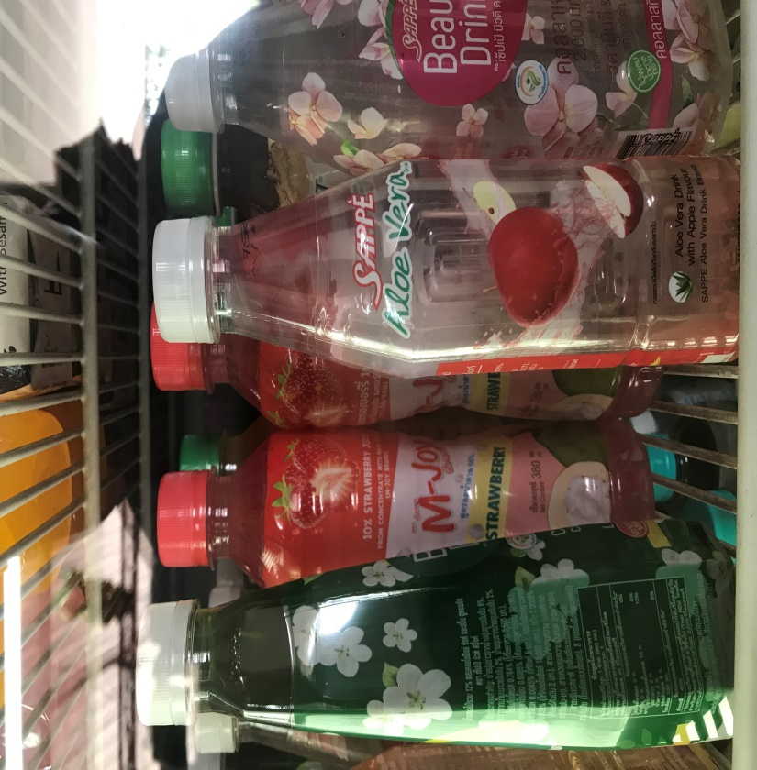
Quick-acting sugar
A tablespoon of sweet syrup 3 sugar cubes
120ml of juice or non-diet soft drinks

Slide 44
If glucagon and glucose gel are unavailable
What could be use
A power from of glucose
(glucose D25 or anhydrous glucose)
Honey
***The sugar liquid should be not be given forcibly and the child should be put in lateral position

Slide 45
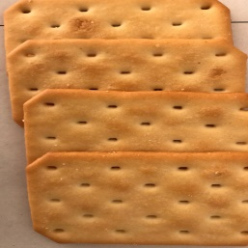
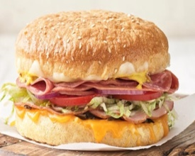
Extra Snacks
Eat me !
Extra Snack
Or
or
Then have one of these
They will keep your sugar from falling back drown again.
4 crackers
2 peanut butter sandwich crackers
1 cup of cereal
A sandwich
Or regular meal or snack
Complex-carbohydrates

Slide 46
If sever hypoglycemia
Hospital setting- Give IV 10% glucose 2-3 mL/kg
Home setting- IM or SQ glucagon
Glucagon 1UI > 25 kg
0,25 < 25 kg

Slide 47
Conclusion
To know to manage insulin and carbohydrate intake during sick days
To know how to manage Hypoglycemia/DKA

Slide 48
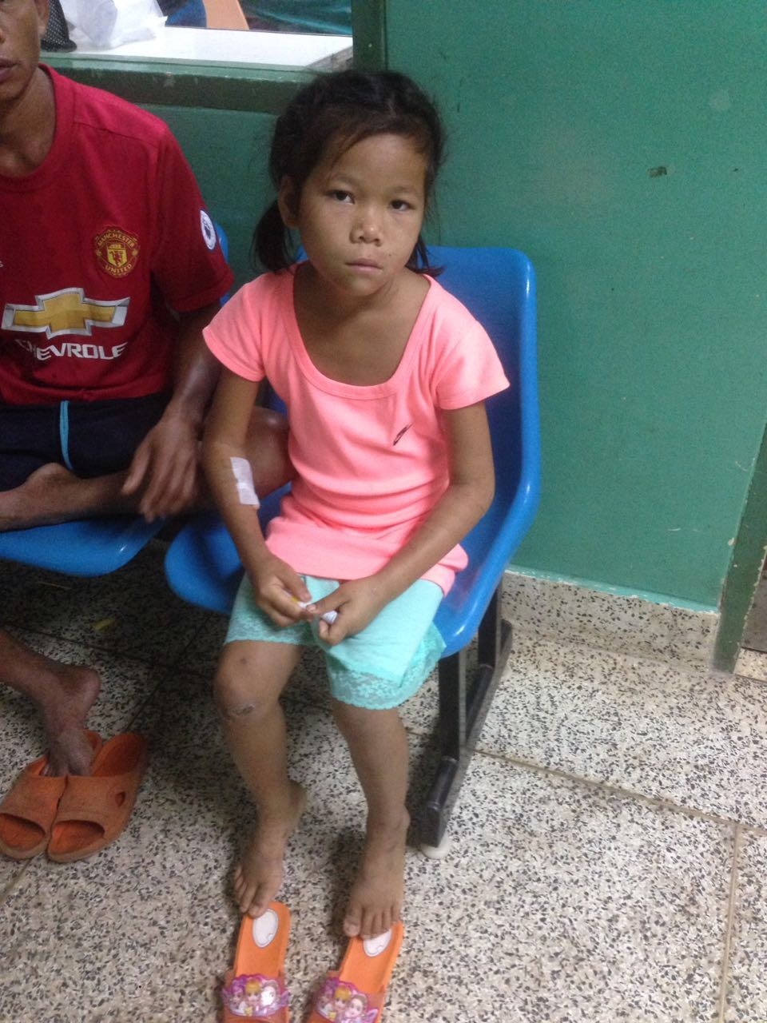
Thank you for your attention

