Slide 1
Pediatric Oncology Emergency
Sonephet SAYSOULIGNO. MD
Pediatric Hemato-Oncologist
Head of Hemato-Oncology Department
Children Hospital, Vientiane Capital
26/4/2019

Slide 2
What is an Oncologic Emergency?
A clinical condition resulting from a metabolic, neurologic, cardiovascular, hematologic and/or infectious change caused by cancer or its treatment that requires immediate intervention to prevent loss of life or quality of life.

Slide 3
Classifications | Oncologic Emergencies
Metabolic | Tumor Lysis Syndrome SIADH ( Syndrome of Inappropriate antidiuretic hormone secretion)
Neurological | Spinal Cord Compression Brain metastasis/ICP
Cardiovascular | Malignant Pericardial Effusion Superior Vena Cava Syndrome Mediastinal obstruction syndrome
Hematology | Hyperleukocytosis/hyperviscosity Disseminated intravascular coagulation
Infections | Febrile Neutropenia Septic shock
GI | Typlitis

Slide 4
Oncologic emergency
Febrile Neutropenia (FN)
Tumor lysis syndrome (TLS)
Hyperleukocytosis
Superior Vena Cava syndrome

Slide 5
Febrile Neutropenia ( FN )

Slide 6
ນິຍາມຂອງ Febrile neutropenia
ມີໄຂ້ ≥ 38 ອົງສາ ນານເກີນ 1 ຊົ່ງໂມງ ຫລື ≥ 38.3 ອົງສາ 1 ຄັ້ງ
ມີພາວະເມັດເລືອດຂາວຕໍ່າ ANC (Absolute neutrophil count)= ≤500 cell/mm3 or < 1,000 cell/mm3 ແລະມີແນວໂນ້ມທີ່ເມັດເລືອດຂາວຈະຕໍ່າລົງ

Slide 7
ANC
CBC: WBC 1000 cell/mm3PMN 6% Band 1% EO 3% Lymph 90% Hct20 % Plt100,000 cell/mm3
ANC = ?
ANC= 70
WBC x ( Neutrophil% + Band%)/100

Slide 8
Febrile neutropenia
ພົບໃນ:
1.patient with cancer who had CMT /radiation
2.patient with leukemia
3.patient with bone marrow transplant
In febrile neutropenic patients ,
1) signs and symptoms of infection are often subtle because of a lack of inflammatory response AND
2) infection tends to have rapid spreading

Slide 9
ວັນທີ່ໄດ້ຮັບຢາເຄມີ

Slide 10
ຄວາມສໍາຄັນທີ່່ຕ້ອງຮູ້ Febrile Neutropenia
ເປັນພາວະທີ່ພົບໄດ້ເລື້ອຍໆ ຫລັງຈາກໄດ້ຮັບການປິ່ນປົວດ້ວບຢາເຄມີ ເນື່ອງຈາກມີການກົດແອ້ກະດູກຈາກຢາເຄມີ ຫລືການສາຍແສງ
ໄຂ້ ອາດມີສາຍເຫດ ຈາກການຕິດເຊື້ອຫລືບໍ່ແມ່ນການຕິດເຊື້ອກໍ່ໄດ້ເຊັ່ນ: ຈາກຢາເຄມີ, ການສາຍແສງ, ສ່ວນປະກອບຂອງເລືອດ ຫລື ເມັດເລືອດຂາວຕໍ່າເອງ
ການຕິດເຊື້ອໃນພາວະໄຂ້ຮ່ວມກັບເມັດເລືອດຂາວຕໍ່າ ມັກເປັນການຕິດເຊື້ອທີ່ຮຸນແຮງແລະນໍາໄປສູ່ການເສຍຊິວິດ ຈື່ງຕ້ອງຕິດຕາມພາວະນີ້ໂດຍຖືວ່າເປັນພາວະສຸກເສີນ ຕ້ອງບົງມະຕິແລະປິ່ນປົວໂດຍໄວ ນໍາໄຊ້ຢາຕ້ານເຊື້ອທີ່ອອກລິດກວ້າງ (Broad spectrum antibiotic)

Slide 13
Initial Investigations
History & physical exam
Lab assessments
Diagnostic imaging
Microbiologic evaluations
Notes:
13

Slide 14
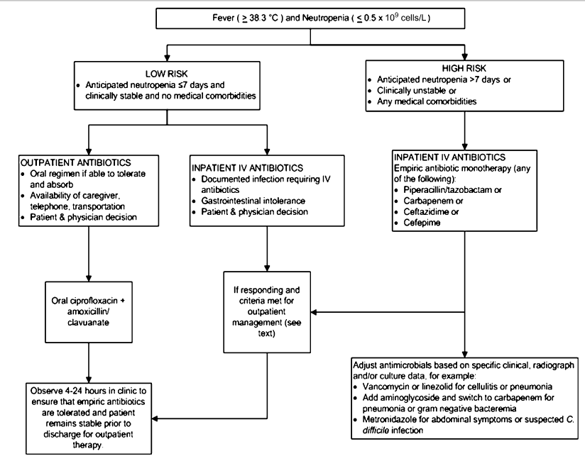

Slide 15
Incidence of Febrile Neutropenia → Febrile Mucositis
 | Low | High
Type of chemotherapy | « Standard » chemotherapy for solid tumor, lymphoma, myeloma | Induction / consolidation chemotherapy for acute leukemia autologous or allogeneic HSCT
Disruption of mucous Membranes | + | +++
Duration of profound neutropenia < 100 cell/mm3 | ≤ 7 days | ≥ 7 days
FEBRILE NEUTROPENIA | 5 – 20 % | 80 – 100%

Slide 16
Low risk of febrile neutropenia
Good clinical manifestration
No pneumonia or sepsis or neurological infection or catheter related
infection
Malignancy in remission phase : rapid onset of bone marrow
function recovery
Good social support(care giver, close F/U)

Slide 17
High risk Febrile neutropenia
Shock
Hypotension
Poor tissue perfusion
ARDS
Confusion
Sign & symptom of sepsis
Agitation

Slide 19
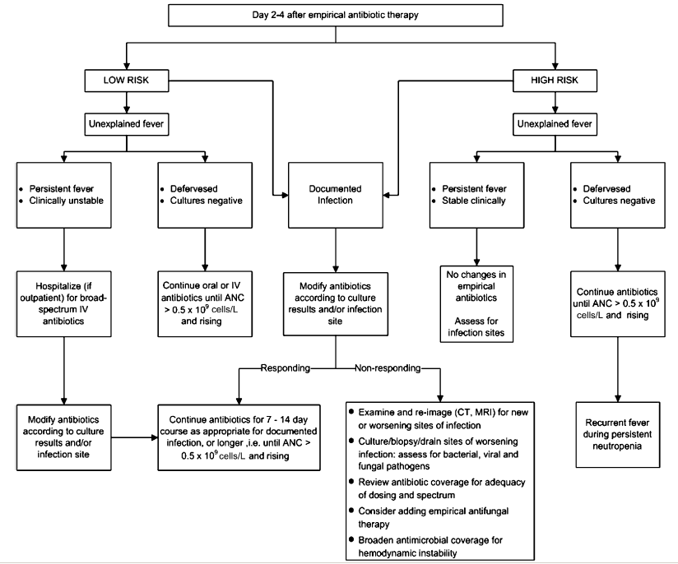

Slide 20
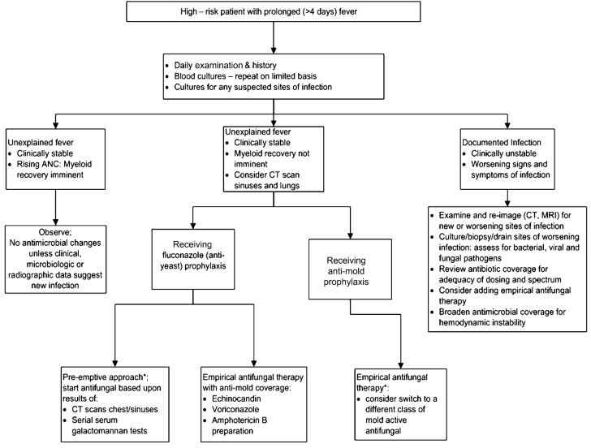

Slide 21
DURATION OF ANTIBIOTIC THERAPY
Minimum 1 week of therapy if
Afebrile by day 3
Neutrophils >500/mm³ (2 consecutive days)
Cultures negative
Low risk patient, uncomplicated course
> 1 week of therapy based if
Temps slow to settle (>3 days)
Continue for 4-5 days after neutrophil recovery (>500/mm³ )
Minimum 2 weeks
Bacteraemia, deep tissue infection
After 2 weeks if remains neutropenic (< 500/mm³), but afebrile, no disease focus, skin intact, no catheter site infection, no invasive procedures or ablative therapy planned. Stop antibiotics and observe.

Slide 22
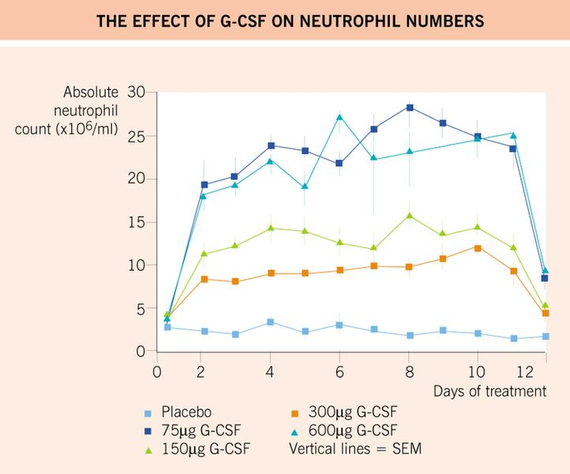
G-CSF

Slide 23
Tumor lysis syndrome (TLS)

Slide 24
Tumor lysis syndrome (TLS)
8 year old male presents with rapidly distending abdomen, first noticed 4 days ago
febrile, anorexic, pale; stooled yesterday; decreasing UOP
PE: mild distress, large palpable discreet mass in right lower abdomen
CT: large mass near ileocecum
CBC:
WBC 100.000
3% blasts
mild anemia.
chemistries:
LDH 22,000 U/L (quite high)
uric acid: 12 mg/dL (quite high)
K: 6.1 mmol/L (elevated)
creatinine: 1.3 mg/dL (elevated)
phos: 9 mg/dL (elevated)

Slide 25
Hyperkalemia.
Hyperphospatemia.
2^{ry} Hypocalcemia.
Hyperuricemia.
Uremia.
High creatinine.
Oliguria.

Slide 26
TLS
sudden burden of intravascaular potassium, phosphate and uric acid spilled by dying tumor cells
rhabdomyolysis
crush injuries
thermal injuries (burns/hypothermic exposure)
typically seen at initiation of therapy for new malignancy, but MAY BE SEEN AT PRESENTATION
consequences:
acute renal failure (urate and CaPhos crystal tubulopathy)
cardiac dysrhythmias
acute hypocalcemia

Slide 27
Incidence:
70% of hematological malignancies → laboratory criteria of TLS.
3% with clinical TLS.
Associated with hematological malignancies:
ALL
AML
Lymphomas
Solid tumors

Slide 28
TLS
identifying patients at risk:
lymphomas:
Burkitt’s lymphoma (practically, any NHL with short doubling time and bulky disease)
leukemias:
Peripheral WBC (>100k/microL)
Large extramedullary disease burden: massive HSM, bulky T cell leukemia/lymphoblastic lymphoma
lymphoproliferative disorders
Chronic myeloid leukemia ( CML )
Juvenile myelomonocytic leukemia ( JMML )
- Solid tumor

Slide 29
Maybe precipitated by :
Chemotherapy
steroids
Radiotherapy.
Hormonal agents.
Risk factors:
Tumor type
Dehydration
Preexisting renal insufficiency
Nephrotoxic medications
High LDH in TLS is indicative of likely progression to ARF

Slide 30
TLS
Management:
hyper-hydration:
beware of oliguria
2-3 L/m²/day (2-3 x maintenance) of NON POTASSIUM CONTAINING IVF
Alkalanization
be CAUTIOUS: give supplemental calcium only with EKG changes with hyperkalemia or symptomatic hypocalcemia

Slide 31
TUMOR LYSIS SYNDROME
Specific management:
Hyperkalemia:
Ca gluconate
Na Bicarbonate
Insulin & Glucose
Salbutamol
DIALYSIS , K > 5

Slide 32
TUMOR LYSIS SYNDROME
Hyperphosphatemia & 2ry Hypocalcemia:
Phosphate binders eg. Aluminum antacids.
Avoid unnecessary Ca supplements.
PO4 > 4 is an indication for dialysis.
Consider CRRT (Continuous renal replacement therapy)

Slide 33
TUMOR LYSIS SYNDROME
Hyperuricemia:
Urine Alkalinization
Urine pH > 6 and < 7.5
Avoid urine pH more than 7.5 “may lead to massive phosphate crystalluria and phosphate precipitates”.

Slide 34
Tumor Lysis Syndrome
Allopurinol:
Xanthine oxidase inhibitor:
Xanthine Hypoxanthine
Xanthine oxidae -→
-ve
allopurinol
Uric Acid
Blocks production of new Uric acid
Increased levels of uric acid precursors; Xanthine→ nephrotoxic
Impairs chemotherapy metabolism

Slide 35
TUMOR LYSIS SYNDROME
Hyperuricemia: cont.
Non recombinant urate oxidase (Uricozyme)
urate oxidase
Uric Acid --------------------------→ Allantoins “highly soluble in urine”
Recombinant Urate Oxidase (Rasburicase)
Effective: Single dose decreases uric acid from 15 to 0.4 mg/dl in 24 hrs
Costs ???

Slide 36
TLS
allopurinol
inhibits hypoxanthine oxidase
enzyme critical in metabolic pathway from purine → → →uric acid
rasburicase
urate oxidase
converts uric acid to soluble metabolite (allantoin)
$$$$$
begin treating malignancy!!!!

Slide 37
hyperleukocytosis

Slide 38
hyperleukocytosis
7 year old male presents to ED with CC of decreased energy x 7 days, unresponsive today
exam:
confused, averbal
pupils anisocoric, but responsive
hemiparesis
pallor
tachycardic with gallop
massive HSM
CBC:
WBC: 327000, blasts 94 %
hgb: 4.6 g/dL
plts: 16K
DIC panel:
PT: 24 seconds (prolonged)
PTT: 28 seconds (normal)
firbrinogen: 60 (low)
D-Dimers: 4100 (elevated)

Slide 39
hyperleukocytosis
patient intubated
surgery emergently consulted to place vas-cath
patient leukapheresed x multiple cycles in PICU
flow cytometry: acute T-cell lymphoblastic leukemia
progressed to renal failure,

Slide 40
hyperleukocytosis
presence of excessive blastemia in the leukemic
defined by peripheral WBC of at least 100K/microL
risk of symptomatology greatly increased for counts of 300K/microL or more
risk of symptomatology greatly increased in AML and CML with increased circulating myeloblasts
seen in
AML: 5%- 20% at presentation
ALL: 9% - 13% at presentation
CML: nearly all patients at presentation

Slide 41
hyperleukocytosis
pathophysiology:
supraphysiologic whole blood viscosity: LEUKOSTASIS
aggregation of blasts in microvasculature
MYELOBLASTS contribute to worse outcomes in AML or CML
larger than lymphoblasts
less distensible than lymphoblasts
“stickier” than lymphoblasts

Slide 42
hyperleukocytosis
Pathophysiology
inappropriate activation of soluble phase clotting cascade
microvascular occlusion
distal ischemic injury/metabolic acidosis
MAHA (on top of myelophthistic cytopenias)
DIC
reperfusion hemorrhage
MSOF (CNS, pulmonary, renal, hepatic, cardiac, dactylitis, priapism, etc.)
Notes:
Multi system organ failure

Slide 43
hyperleukocytosis
Interventions → → DECREASE WHOLE BLOOD VISCOSITY:
primary intervention: CYTOREDUCTION
leukapheresis
cytoreductive chemotherapy
immediately notify heme/onc
we will urgently activate ARC cytapheresis folks
immediately begin hyper-hydration (2-3 x maintenance) with non-K+ containing IVF
AVOID PRBC transfusions!
markedly increase whole blood viscosity
if necessary, transfuse with ceiling hgb of 8-9 g/dL
may transfuse platelets liberally if necessary

Slide 44
hyperleukocytosis
interventions:
correct coagulopathy???
depends!
make plans for urgent placement of vas-cath
manage TLS
who gets leukapheresed?
ANY PATIENT WHO IS SYMPTOMATIC FROM SUSPECTED LEUKOSTASIS SYNDROME
asymptomatic patients:
suspected AML: WBC > 100K/microL
suspected ALL: WBC > 200K/microL
suspected CML: WBC > 200K/microL

Slide 45
superior vena cava syndrome

Slide 46
superior vena cava syndrome
12 year old male, previously healthy
6 week history of worsening cough
treated 1 week into symptoms with 2 weeks of systemic steroids for “bronchitis”
initially cough improved and felt much better
now worsening
weight loss
past week:
worsening orthopnea (sleeping upright in chair)
fevers
expanding mass in supraclavicular area

Slide 47
SVCS
exam:
alert and non-toxic; completely oriented
facial edema
no stridor, not dyspneic
tachypneic, absent breath sounds R lung
palpable, firm nodes in right supraclavicular chain
splenomegaly

Slide 50
SVCS

Slide 51
SVCS

Slide 52
SVCS
CBC:
WBC: 12K/microL, 13% blasts
hgb: 11.9 g/dL
plts: 144K/microL
quantitative βhCG (tumor marker): normal
quantitative AFP (tumor marker): normal
stat peripheral flow: T cell acute lymphoblastic lymphoma (leukemia?)

Slide 53
SVCS
Interventions:
ICU observation
begun on empiric high dose solumedrol
based upon presence of blasts in smear
next day, begun on induction chemotherapy per flow cytometric diagnosis

Slide 54
SVCS
signs and symptoms from impedence to flow in the SVC
plethora
facial edema
JVD
dyspnea
orthopnea
cough
stridor
for advanced SVC obstruction, may see
confusion
lethargy
headache
vision changes
usually, abnormal SVC flow results from extravascular compression, not a primary intraluminal thrombus

Slide 55
SVCS
causes: mediastinal badness
malignancy
NHL (70% of malignant causes of SVCS)
HL
neuroblastoma
leukemias***
germ cell tumors
granulomatous disease
aortic aneurysms
primary SVC thrombus

Slide 56
SVCS
accurate diagnosis is critical...
...however, tissue acquisition can be problematic
do NOT sedate
do NOT give anxiolytics
avoid anything which will compromise
muscular tone
venous return
an already taxed cardiopulmonary state

Slide 57
SVCS
workup:
CXR, CT to evaluate mass location, size, airway patency, encasement of vessels, presence of pleural effusion, etc.
evidence of hematolymphoid malignancy?
BLASTS on peripheral smear
empirically send peripheral blood flow cytometry
bone marrow aspirate and biopsy under local anesthesia
meticulous lymphatic exam
may reveal tissue source obtainable via local anesthetic only
urine catecholamines (VMA/HVA) if clinical picture consistent with neuroblastoma
serum QUANTITATIVE (tumor marker) βhCG and AFP for GCT
transthoracic echocardiogram: presence of pericardial effusion
PPD/ID titers

Slide 58
SVCS
consult anaesthesia for symptomatic or unstable patient
unstable for general anesthesia:
>50% reduction in cross-sectional diameter of trachea at any level
<50% predicted PEFR on PFT’s

Slide 59
SVCS
interventions:
ultimately, begin treatment for underlying cause
however, may BE FACED WITH UNSTABLE PATIENT and no diagnosis:
awaiting pathologic analysis of obtained sample, or
danger of obtaining any sample for tissue diagnosis
initiate empiric therapy:
solumedrol: 2 mg/kg/day divided tid
external beam radiation
if high clinical suspicion of GCT or NBL, initiate appropriate chemotherapy

Slide 60
Thank you

