Slide 1
Case presentation
Khounthavy Phongsavath MD
National Children Hospital, Vientiane
15th Annual Pediatric Continuing Medical Education Conference
25th April 2019, Vientiane

Slide 2
General information
A 3-year-old previously healthy female from Somsamai Village, Xaithany District, Vientiane Capital
Day of admission: 22/2/2019 (00h:30)
Chief complaint: FEVER d2 and RASH

Slide 3
History of present illness
2 days PTA she developed high-grade fever with rhinorrhoea and cough. The parents took her to a health care centre.
Dx: ?
Tx: paracetamol and antihistamine medication orally.

Slide 4
History of present illness
1 day PTA she developed nonpruritic rash on her face. During the following 24 hours rash spread all over her body. The symptoms were associated with 2 episodes of vomiting, 3 episodes of watery stool and poor appetite. The cough increased and she developed dyspnoea, her parents took her to NCH on 22/2/2019

Slide 5
Past Medical History
8th child in the family
Pregnancy: normal, uncomplicated, ANC at health care centre
Delivery: normal term delivery in hospital, BW 3000g
Perinatal period: no complications
Development: normal development.
Immunization: incomplete (BCG, Hib0, DTP1+ OPV1+PCV1)

Slide 6
Past Medical History
Surgical Hx: no surgical interventions
Allergies Hx: none
Family Hx: 6 healthy siblings, 1 sibling developed similar symptoms (FEVER + RASH)
Social Hx: many children in her village have fever and rash; no known TB contact; she doesn’t attend school yet

Slide 7
Physical examination in ED
AVPU-> P ; T: 39 C Sat02: 94% (RA) RR: 58 bpm HR:171 bpm BP 97/67 W: 10,6 kg, H: 93 cm, W/H: -2SD to -3SD, W/A : -2SD to -3SD, H/A: 0 to -2SD
HEENT: nasal discharge, nasal flaring, pink conjunctiva, no sunken eye, Koplik’s spots in oral cavity, no lymphadenopathy, no ear discharge
CNS: meningeal signs negative, restlessness
RS: tachypnea, moderate sub-costal/inter-costal/supra-sternal retractions, pectus carinatum, diffuse crepitations bilaterally, no wheezing
CVS: no cyanosis, warm extremities, CRT< 2sec, pulse volume strong and symmetric, tachycardia, S1-S2 normal, no heart murmur
GI : abdomen soft, not painful on palpation, no hepatosplenomegaly
SKIN: generalized erythematous confluent maculopapular rash, no bleeding

Slide 8
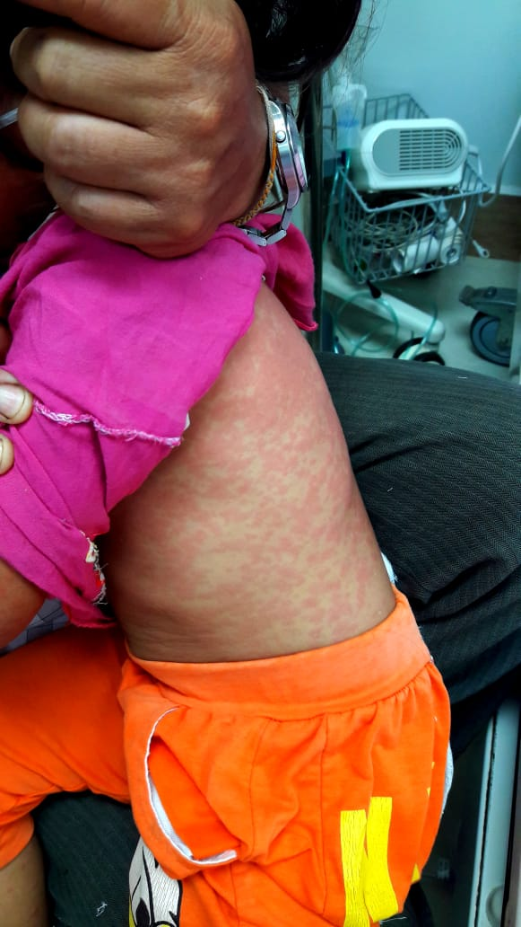

Slide 9
Positive findings
A 3 year-old girl with:
Fever
Generalized confluent erythematous maculopapular rash
Rhinorrhoea and cough
Nasal flaring and chest retractions
Crepitations bilaterally
Vomiting and diarrhoea
Restlessness
Moderate acute malnutrition
→ ACUTE FEVER with ERYTHEMATOUS RASH

Slide 10
Approach to FEVER with RASH
Infectious | Viral infections | Measles Rubella Roseola(HHV 6 and 7) Erythema infectiosum (Parvovirus) Epstein-Barr virus (EBV) Dengue
 | Bacterial infections | Scarlet fever Rickettsia
Non- infectious | Rheumatologic disorders | Acute rheumatic fever Kawasaki disease Henoch Schoenlein purpura
 | Medication reactions | Erythema multiforme Stevens Johnson syndrome

Slide 11
Differential diagnosis:
Measles with severe pneumonia
Dengue fever
Scarlet fever
Additional diagnosis:
Moderate acute malnutrition

Slide 12
Follow-up in ED
22-02-19 (23:10) Vital sign | Problem list | Treatment | Plan
T:39 P:171 RR:58 SpO2:94% W:10,6kg H:93cm | Fever Severe pneumonia Diarrhea Moderate acute malnutrition DDx: Suspected MEASLES Scarlet fever? Dengue fever? | On O2 via nasal cannula 1L/min IV NS Paracetamol (15Mkd) Ceftriaxone (100MKD) Isolated room at ICU | Report a case of fever and rash to National Center for Laboratory and Epidemiology (NCLE)

Slide 13
Investigations
CBC
Glucose
Electrolytes
LFTs, RFT
CRP
DF test
Blood sent for measles IgM and IgG
Throat swab for group A Streptococcus (GAS)
Chest X-ray

Slide 14
Laboratory results
CBC
WBC | 8.06 x10⁹/l
LYM | 12 x10⁹/l
MON | 0.2 x10⁹/l
GRA | 87.8 x10⁹/l
HGB | 11.1 g/dl
HCT | 34.32 %
MCV | 55 fl
MCH | 17.8 pg
PLT | 279.000 x10⁹/l
Rapid test for dengue | NS1 (-), IgM(-) IgG(-)
Biochemistry
K+ | 3.45 mmol/l
Na+ | 136.8 mmol/l
Cl- | 88.8 mmol/l
Glucose | 108 mg/dl
SGOT | 64 IU/l
SGPT | 17 IU/l
Urea | 19.9 mg/dl
Creatinine | 0,40 mg/dl
CRP | 139.1 mg/l

Slide 15
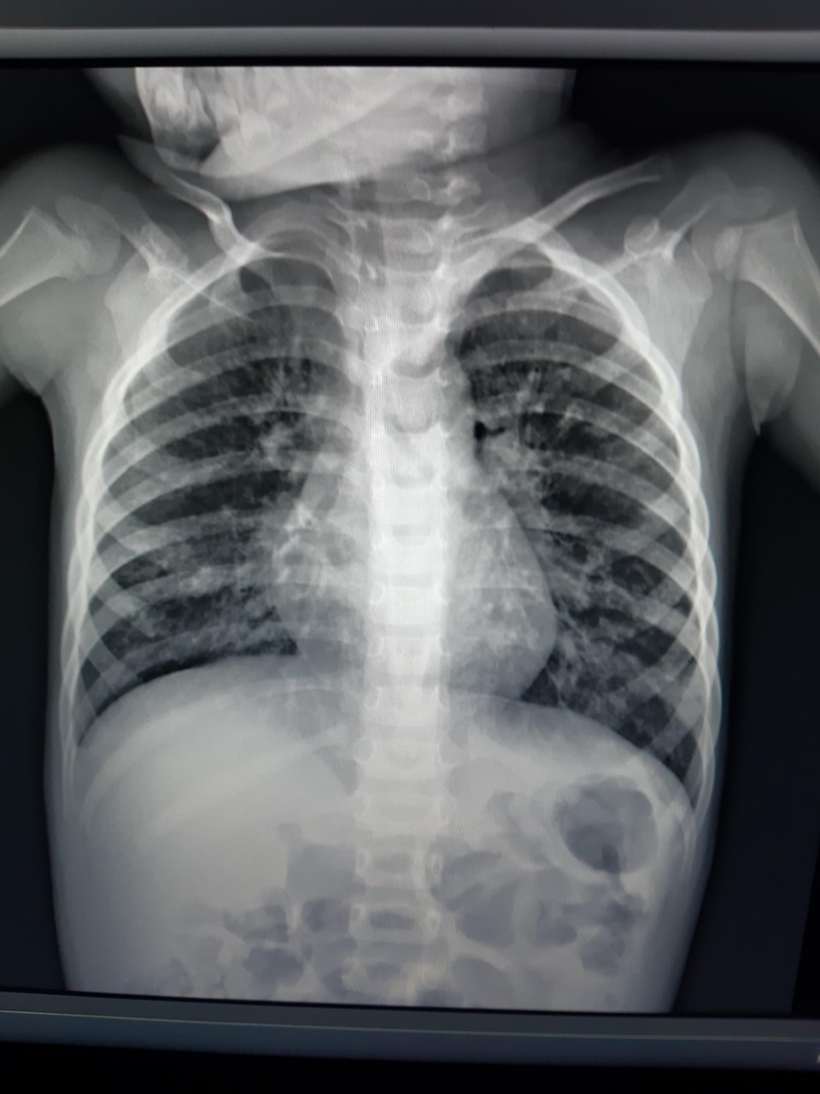
Chest X-ray

Slide 16
Follow-up in ICU
22-02-19 (23:10) Vital sign | Problem list | Treatment | Plan
T:39 P:171 RR:58 SpO2:94% W:10,6kg H:93cm 23/02/2019 14h00 | Fever Severe pneumonia Diarrhea Moderate acute malnutrition Suspected MEASLES No fever for 8hr No sign of severe respiratory distress | Isolated room at ICU Isolated medical equipment ( oximeter, , stethoscope, monitoring) On O2 nasal cannula 1L/min Iv fluid Paracetamol (15Mkd) Ceftriaxone (100MKD) Follow-up every 2-4h Continue treatment Try to wean oxygen/SaO2:98%(RA) Add: Vit A 200.000 IU d1 d2 and d14 | -Report to NCH Director suspected measles case -Consult nutrition team -Give Vitamin A 200.000 IU on d1, d2 and d14 Move to IDW Isolated room

Slide 17
Follow-up in ID ward
23-02-19 Vital sign | Problem list | Treatment | Plan
T: 37 P: 137 RR: 42 Spo2:98% BP: 94/68 | No fever pneumonia Moderate acute malnutrition NCLE reported: Measles IgM (+) positive Dx: Complicated measles with severe pneumonia | - Isolated room at ICU - Isolation until 5 days of rash - Separate medical equipment (oximeter, stethoscope….) Hand wash Face Mask - IV fluid - Paracetamol (15Mkd) Ceftriaxone (100MKD) Add: Vitamin A 200.000 IU d1 | - Reported to Director NCH - Give MR vaccine for health workers, student and people exposed to measles case as soon as possible

Slide 18
24/02/19 | Problem list | Treatment
T: 37 P: 107 RR: 34 Spo2 : 99% ( RA) BP: 100/70 | Measles with severe pneumonia →rash decreased →No respiratory distress →Crepitations over the lungs Moderate acute malnutrition | Perfalgan 1g (15MKdose) Ceftriaxone (100MKD) Vit. A 200.000UI d2 Sp. Multivitamin
25/2/2019 T: 37 P: 98 RR: 30 Spo2: 99% (RA) BP: 100/70 | Measles with severe pneumonia →no rash →No respiratory distress →Crepitations over the lungs decreased Moderate acute malnutrition | Off IV Antibiotic Start cefixime orally for 3 days Discharged home Plan: -give vit. A on d14 -follow-up visit

Slide 19
Measles virus
Mode of transmission:
Airborne
Direct contact with infectious droplets
Measles virus can remain infectious in the air for up to 2 hours after an infected person leaves an area.

Slide 21
Severe measles complications
1 : 20 children gets PNEUMONIA
PNEUMONIA is the most common cause of death from measles in young children

Slide 23
Prevention of measles transmission at NCH
Prevention of nosocomial infection at NCH
Triage at ED – patients with fever and rash or coryza, conjunctivitis, cough sent immediately to an assigned separate examination room Face mask for measles case when transported in the hospital (preferably N95 mask; regular mask if N95 not available) 3. Isolation room for hospitalized measles cases up to day 5 of rash 4. Separate medical equipment (stethoscope, oximeter, monitoring) 5. Hand washing and use of hand sanitizer 6. Examination room not used for 2 hours after occupied by a patient with suspected/known measles 7. Offering MR vaccine to exposed unvaccinated/vaccinated with less than 2 doses of MR exposed patients/family as soon as possible (within 72 hr from exposure)

Slide 24
Prevention of measles transmission at NCH
Public health
Reporting a suspected measles case to the Director of NCH Reporting a suspected measles case to the NCLE, MOH, WHO Introducing transmission prevention measures at NCH and sending blood sample for measles confirmation
Prevention of measles transmission to staff
Face mask when having contact with suspected/known measles case (preferably N95 mask, regular mask if N95 not available) Hand washing and use of hand sanitizer 3. Providing MR vaccine for the staff who is unvaccinated, vaccinated with less than 2 doses of MR or exposed as soon as possible(within 72 hr from exposure)

Slide 25
Summary: 4 x I
IMMUNIZE with MR
IDENTIFY measles (FEVER with RASH)
ISOLATE
INFORM public health authorities

Slide 26
Thank you!

