Slide 1
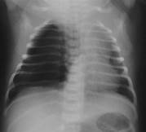
Special Considerations

Slide 2
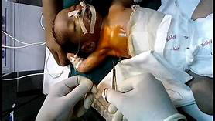
Objectives
Suspect and manage Pneumothorax and pleural effusion
How to manage a newborn with airway obstruction
Manage congenital lung abnormalities that complicate resuscitation
Babies who require resuscitation after neonatal period or outside the hospital delivery room

Slide 3
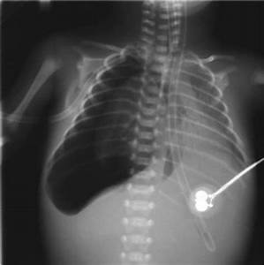
Pneumothorax
Abnormal air in pleural space surrounding lungs,
prevents lung fully expanding within the chest
severe respiratory distress and bradycardia
If large PTX the pressure from trapped air
lungs to collapse,
interfere with blood flow in chest,
severe respiratory distress: O2 desat, bradycardia
tension PTX.
Life threatening EM requires urgent treatment

Slide 4
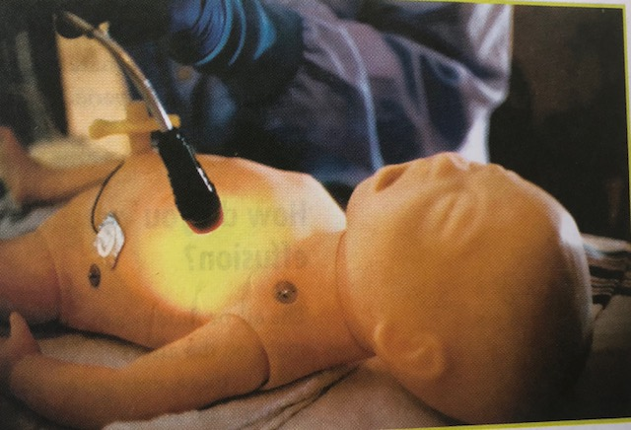
Suspect Pneumothorax
Baby fails to improve with resuscitation
Baby suddenly develops
severe respiratory distress, bradycardia, hypotension
Breath sound diminished on side of PTX
Transillumination of the chest
Treat by placing catheter into pleural space and evacuating the air

Slide 5
Pleural Effusion

Slide 6
Pleural Effusion
Fluid that collects in pleural space
Caused by Edema, infection, leakage from lymphatic system
History of fetal anemia, twin to twin transfusion, cardiac arrhythmia, congenital heart disease, congenital infection, genetic syndrome
Suspect if
Respiratory distress and generalize body edema (hydrops fetalis), ascites, pericardial effusion
Lung sounds decreased on affected side
CXR evidence
If severe respiratory distress, doesn’t resolve with intubation, PPV
Insert a catheter into pleural space and drain fluid

Slide 7
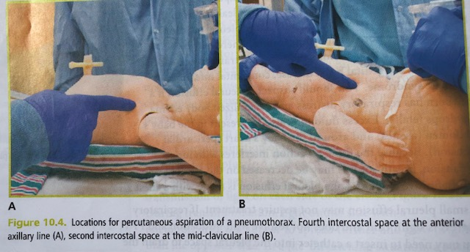
Evacuation pneumothorax: Thoracocentesis
Aspiration site and positioning
4th intercostal space at the anterior axillay line OR
2nd intercostal space at the mid clavicular line
Small blanket roll under affected side to rise upward
Notes:
Upward allows air to rise to the upper portion of the chest

Slide 8
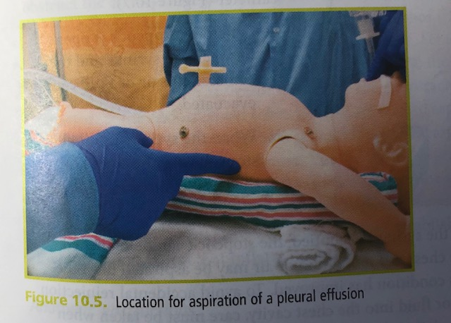
Evacuation of Pleural effusion
Aspiration site
5th or 6th intercostal space along the posterior axillary line

Slide 9
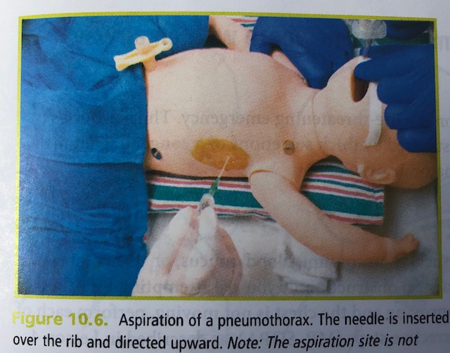
Procedure
Prepare site with topical antiseptic and sterile towels
Insert an 18 or 20 gauge percutaneous catheter over needle device perpendicular to chest wall, just over the top of the rib
Pneumothorax:
direct catheter upward
Pleural effusion
direct catheter downward
Notes:
Avoid puncturing the blood vessels located under each rib

Slide 10
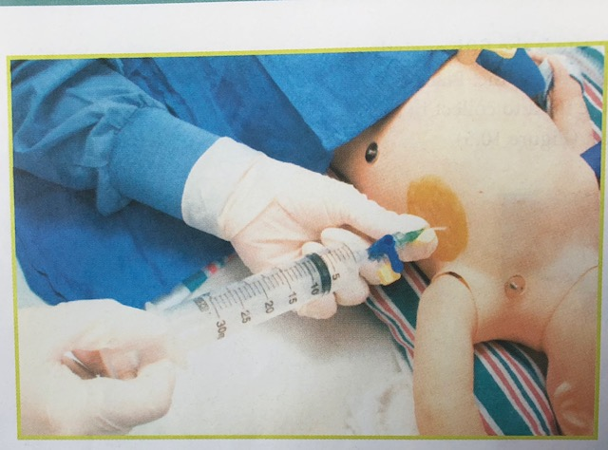
Thoracocentesis
Once pleural space entered, remove needle, connect large syringe to catheter and remove air/fluid
Avoid letting air into chest
Send sample fluid to lab
CXR after procedure

Slide 11
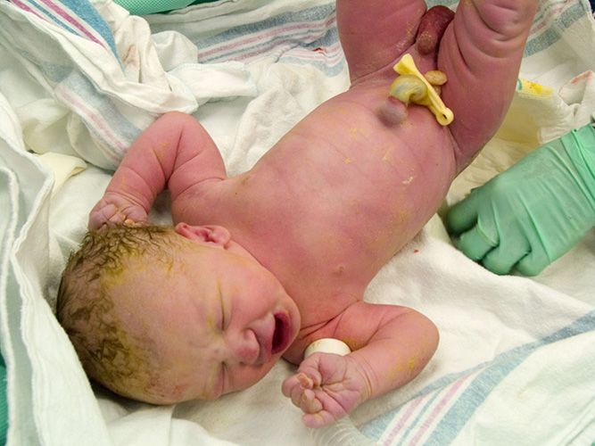
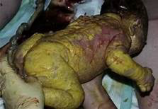
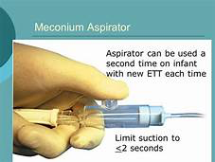
Manage baby with airway obstruction
Thick secretions: meconium, blood

Slide 12
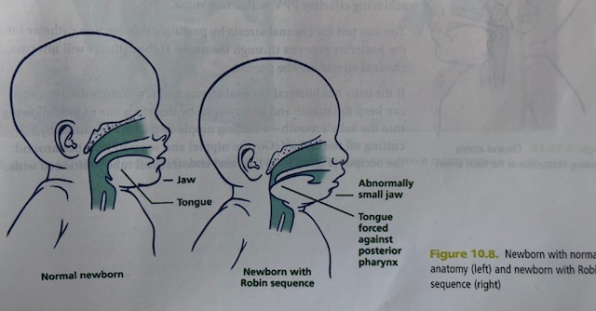
Anatomic Airway Obstructions
Pierre Robin
Abnormally small lower jaw, tongue large, cleft palate
Turn baby onto stomach,
small 2.5mm ET tube in posterior pharynx (not in trachea)
LMA
Oral, nasal, neck masses
ET tube, or LMA

Slide 13
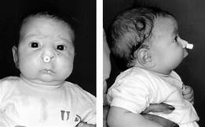
By pass airway obstruction

Slide 14
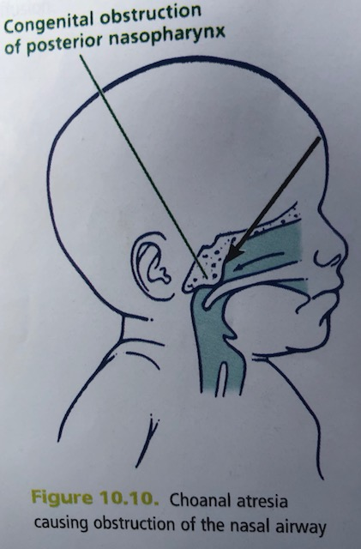
Anatomic Airway Obstruction
Choanal Atresia
Nasal airway obstructed by bone or tissue
Breath when cry, cyanosis and respiratory distress when sleep/feed
Pass small catheter through nares to diagnose
If bilat: keep mouth and airway open with
McGoven Nipple
oral ET tube in pharynx, or
oral (Guedel) airway

Slide 15
Keep airway open

Slide 16
Keep airway open: Mcgoven Nipple

Slide 17
Abnormalities of fetal lung development that complicate resuscitation
Congenital diaphragmatic hernia, mainly left side
Diaphragm malformed
Intestines, stomach, and liver can enter chest
Prevent lung from developing: pulmonary hypoplasia
Scaphoid abdomen, respiratory distress, hypoxemia,
Decreased breath sounds on hernia side, gurgling heard from intestines
If PPV administered: gas enters stomach and intestines
Inhibits lung inflation
Pneumothorax may develop
Notes:
Pulmonary hypertension often present, severe hypoxemia

Slide 18
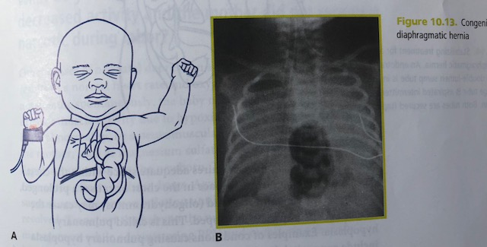

Slide 19
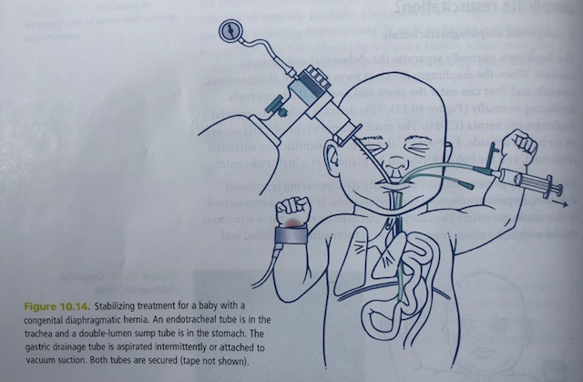
Management diaphragmatic Hernia in newborn
Promptly intubate and place large orogastric catheter (10F)

Slide 20
Resuscitating Newborns outside hospital
Initial priority for resuscitation, regardless of location, is to restore adequate ventilation
Temperature management
Dry, change towels, skin to skin
Plastic wrap, hat
Clearing the airway
Bulb syringe, wipe mouth and nose with clean cloth wrapped around finger
Ventilation
Drying, stimulation
PPV with bag and mask or mouth to mouth and nose
Sniffing position
Chest compression
3:1 compression to ventilation
Vascular access
IO

