Slide 1
Post resuscitation Care

Slide 2
Objectives
What to do after resuscitation
Medical conditions that occur after resuscitation
Management considerations after resuscitation

Slide 3
Post resuscitation care
NN who required resuscitation may have problems during transitional hours, even if Vital Signs back to normal
Complications may involve multiple organ systems
Complications can be anticipated and promptly addressed by monitoring

Slide 4
Post resuscitation Care
Frequent evaluation VS
May require ongoing respiratory support
Supplemental 02, Nasal CPAP, mechanical ventilation
NICU level care
Encourage parental presence and envolvement

Slide 5
Medical Conditions
Pneumonia, other respiratory problems
Need for resuscitation may be early sign pneumonia, perinatal infection, aspiration
Grunting, nasal flaring, retraction
Respiratory distress syndrome? Retained fetal lung fluid? Pneumonia?
Labs, start antibiotics, Chest Xray
Acute respiratory deterioration:
Pneumothorax, ET tube dislodged/obstructed

Slide 6
Post resuscitation problems
Pulmonary hypertension –PPHN
Pul blood vessels remain constricted after birth
Give O2 and mechanical ventilation
Avoid high levels O2 sat
Avoid unnecessary suction, excessive stimulation
Monitor with pulse oximetry and arterial blood gas
Notes:
> 34 wks gestation

Slide 7
Post resuscitation problems
Hypotension
Low 02 levels at time of birth, decrease heart function and blood vessel tone
Blood loss
Sepsis
Give volume expanders if evidence of hypovolemia
Dopamine or dobutamine
Improve cardiac output and systemic blood flow

Slide 8
Post resuscitation problems
Hypoglycemia
Glucose consumption increased when metabolism occurs without adequate 02
Glucose stores depleted rapidly in stress
Glucose is essential fuel for brain
Check glucose levels frequently and give IV dextrose 10% as needed

Slide 9
Post resuscitation problems
Feeding problems
Newborn GI tract sensitive to decreased 02 and blood flow
Feeding intolerance, poor motility, inflammation, bleeding and perforation
Neurological dysfunction affect sucking and oral feeding – need alternate methods nutrition
Start feedings with breast milk (store as needed)

Slide 10
Post resuscitation problems
Renal failure
Hypotension, acidosis, hypoxia cause decrease renal flow
Temporary or permanent
Acute tubular necrosis (ATN) temporary
Fluid retention, electrolyte imbalances: fluid restriction
Later develop high urine output, require additional fluids
Monitor
Urine output, body weight, serum electrolytes

Slide 11
Post resuscitation problems
Metabolic acidosis
Due to tissue hypoxia and hypovolemia
Interferes with cardiac function, worsens pul hypertension
Correct cause of acidosis
Seizures/Apnea
Hypoxic ischemic encephalopathy
Depressed muscle tone, poor respiratory effort, apnea
Seizures after several hours
Other conditions
Maternal narcotics/anesthetics, infection, electrolyte disturbance, metabolic abnormality

Slide 12
Post resuscitation problems
Hypothermia/hyperthermia
Premies prone to hypothermia
Increased mortality
Special techniques to maintain body temperature
Hyperthermia
Fever, maternal chorioamnionitis, infection, radiant warmer dysfunction
Worsens prognosis of HIE

Slide 13
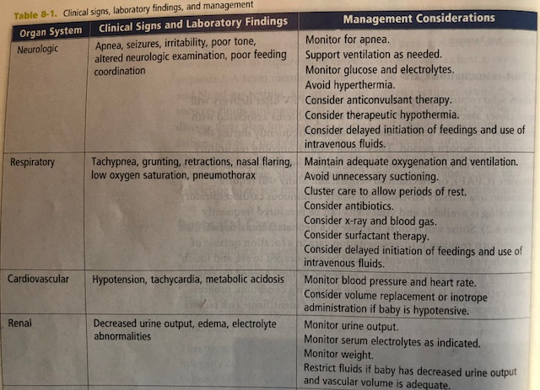
Post resuscitation Care

Slide 14
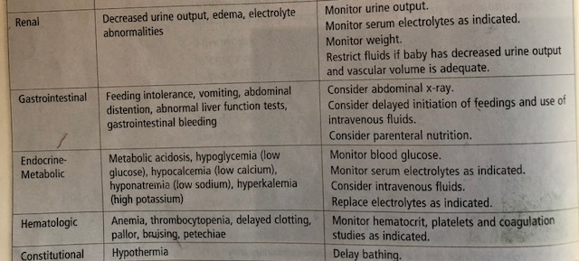
Post Resuscitation Care

