Slide 1
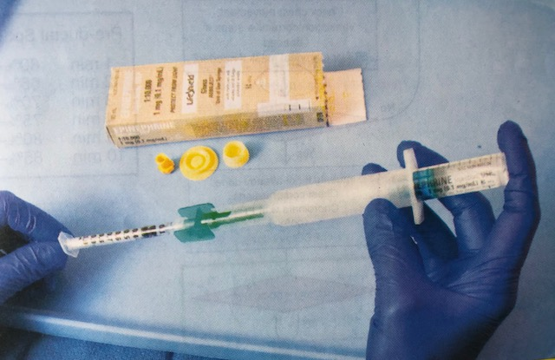
Neonatal resuscitation
Medications

Slide 2
Objectives
When to give epinephrine
How to administer epinephrine
When to give a volume expander
How to administer a volume expander
What to do if baby not improving after IV epinephrine and volume expander
How to insert an Intraosseous needle

Slide 3
Very small number of newborns will require emergency medications
Most newborns will improve without medications
Before medications
Check ventilations and compressions
Epinephrine will coronary artery perfusion and O2 delivery
Newborns with shock from acute blood loss
Bleeding vasa previa, fetal trauma, cord disruption, severe cord compression
May require emergency volume expander
Notes:
Most of these babies are intubated or have LMA
HR < 60= blood flow into the coronary arteries is severely decreased, resulting in such low 02 delivery to nn heart that it cannot contract effectively

Slide 4
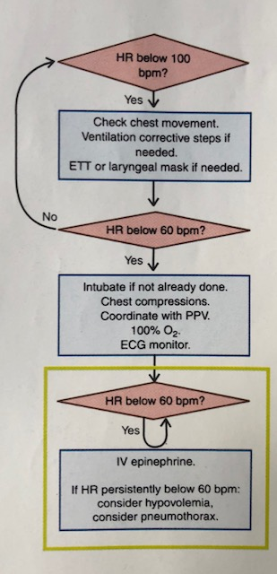

Slide 5
Epinephrine
Cardiac and vascular stimulant
Constricts blood vessels outside of the heart
Increases blood flow into the coronary arteries
Blood in coronary arteries carries 02 - restores cardiac function
Increases the rate and strength of cardiac contractions

Slide 6
Epinephrine Indication
HR < 60 bpm AFTER
30 sec of PPV that inflates the lungs AND
Another 60 sec of chest compressions coordinated with PPV at 100% of 02
Epinephrine IS NOT INDICATED before you have established ventilation that inflates the lung

Slide 7
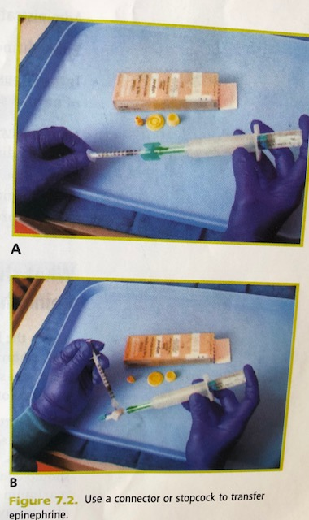
Epinephrine Concentration and Route
Only the 10,000 preparation (0.1mg/ml) used for neonatal resuscitation
Route
IV or IO
Dose: 0.1-0.3ml/kg
Give rapidly
Endotracheal tube
Dose: 0.5-1ml/kg
Follow with PPV breaths to distribute drug into lungs
Notes:
IV/IO recommended/ 0.01-0.03mg/kg
ET: less effective, may give a dose while waiting for other access. Absorption is unreliable and less effective. 0.05-01mg/kg

Slide 8
Notes:
What to expect after giving epi: may take longer than expected.continue ventilation indicated by chest movement and chest compressions, minimized interruptions

Slide 9
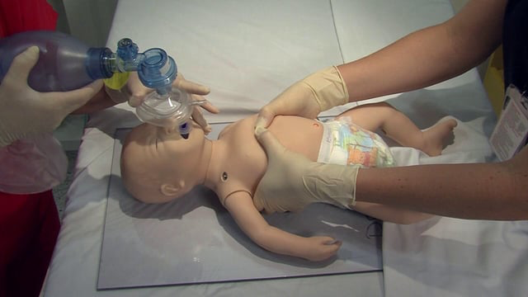
After epinephrine, continue ventilation and compressions

Slide 10
When should you consider administering a volume expander?
Signs of Hypovolemic Shock
Persistent low HR, not responding to effective ventilation, chest compressions, and epinephrine
Pale, delayed capillary refill, weak pulses
Sometimes no sign blood loss
History of acute blood loss
Fetal maternal hemorrhage, bleeding vasa previa, vaginal bleeding, placental laceration, fetal trauma, umbilical cord prolapse, tight nuchal cord, blood loss from umbilical cord, fetal fetal transfusion

Slide 11
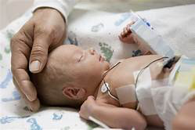
Emergency volume expansion indicated
Baby not responding to the steps of resuscitation AND
Signs of shock OR
History of acute blood loss

Slide 12
What volume expanders should be considered? Administered?
0.9% NaCl (normal saline)
Red Blood Cells (packed)
Dose
10ml/kg, additional 10ml/kg if no improvement
Route
IO
Umbilical venous catheter
Administration
In 5-10 min, a bit slower in premies

Slide 14
What if baby doesn’t improve after IV epi and volume expander?
Continue ventilation and chest compressions
Epi every 3-5 min
Reassess
Chest moving? Equal breath sounds? Is airway device obstructed? Is 100% 02 administered? Is correct compression depth? Correct Epi given?
Is a pneumothorax present?
How long should you continue?

Slide 15
Case Scenario
Become familiar with epi and volume expander equipment
Case scenario

