Slide 1
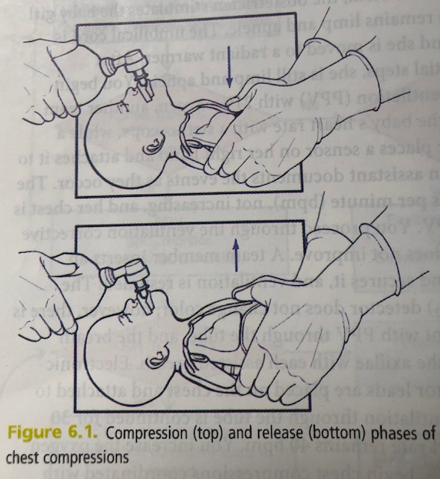
Neonatal resuscitation Chest Compressions

Slide 2
Chest Compressions in Newborn resuscitation: Improves coronary artery blood flow
NN who do not respond to effective ventilation
Have very low blood O2 levels, acidosis, and low blood flow to coronary arteries
Cardiac muscle function is depressed
Compression of sternum
Pushes blood forward, increases diastolic blood pressure in aorta
Release of sternum
Heart refills with blood, blood flows into coronary arteries
Compressing chest and ventilating lungs
Help restore flow of oxygenated blood to heart muscle

Slide 3
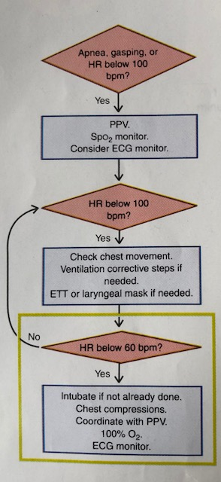
When do you begin Chest Compressions?
When Heart Rate remains < 60 bpm after at least 30 sec of PPV that inflates the lungs
In most cases, ventilation through ET tube or LMA mask

Slide 4
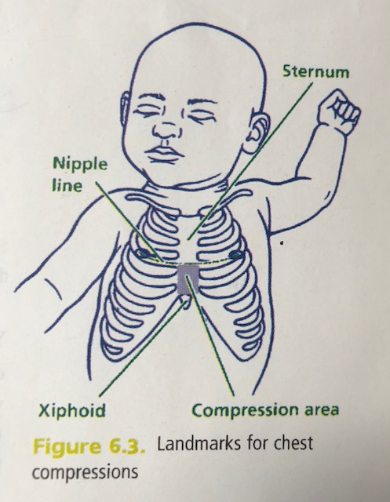
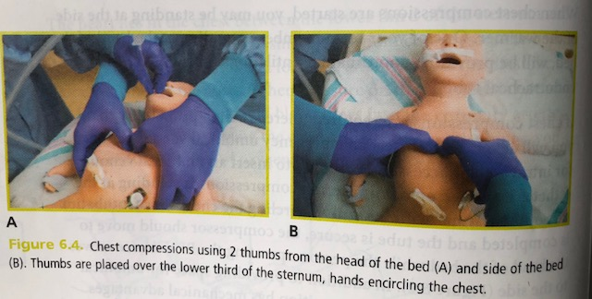
Where do you position your hands during chest compressions?

Slide 5
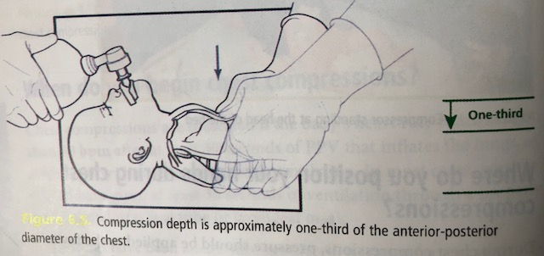
How deeply do you compress the chest?

Slide 6
Compression Rate, coordination with PPV
Compression Rate 90/min
Ventilation Rate 30/min
3 compressions + 1 ventilation every 2 sec
120 “events” / min
One and two and three and BREATH and….
During chest compressions O2 concentration at 100%
Adjust O2 concentration to meet target O2 saturation
Check baby’s heart rate after 60 sec of compression/ventilation
Avoid interruptions
ECG to monitor heart rate

Slide 7
When do you stop Chest Compressions?
When heart rate is > 60 bpm
Continue PPV at 40-60 breaths per minute
If HR < 60 bpm
Check quality of ventilation and compression
If ventilation and compressions correctly administered:
Epinephrine is indicated

Slide 8
Case Scenario
Practice chest compressions
Case scenario

