Slide 1
Positive Pressure Ventilation
Characteristics of self inflating bags, flow inflating bags and T-piece resuscitators
When to give PPV
How to position newborn’s head for PPV
How to place a resuscitation mask on newborns face
How to administer PPV and assess effectiveness
How to use ventilation corrective steps
How to administer CPAP
How to place an orogastric tube

Slide 2
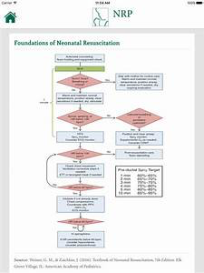

Slide 3
Common terminology for PPV
PIP
Peak inspiratory pressure: highest pressure administered with each breath
PEEP
Positive end expiratory pressure: gas pressure maintained in lungs between breaths when baby receiving assisted breaths

Slide 4
Common terminology for PPV
CPAP
Continuous positive airway pressure: pressure maintained in lungs between breaths when baby is breathing spontaneously
Rate: # of assisted breaths administered per minute
IT: inspiratory time
duration of inspiratory phase of each PP breath
Manometer: gauge used to measure gas pressure

Slide 5
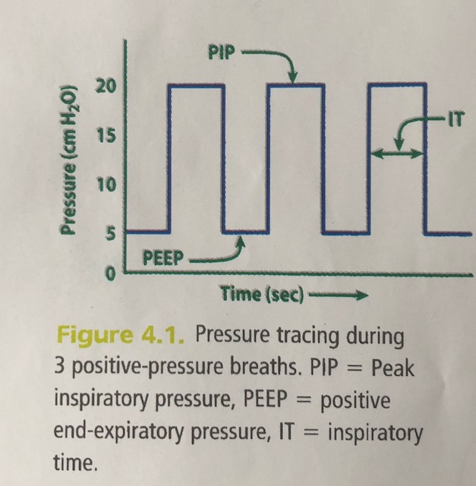

Slide 6
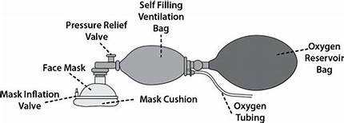
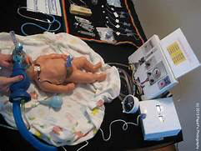
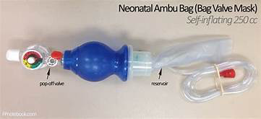
Different types of resuscitation devices used to ventilate newborns: SELF INFLATING BAG
Notes:
If not attached to O2 source, it will fill with room air 21% O2. does not require compressed gas or a tight seal to remain inflated. PIP controlled by how hard bag squeezed. PEEP by valve attached to bag. Gas does not flow out of mask unless gag is squeezed, so cannot administer CPAP or free flow O2. Pop off valve, limits peak pressure to 30-40 cm H2O

Slide 7
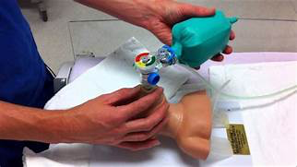
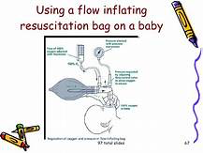
Flow Inflating Bags
Notes:
Inflates only when compressed gas source is flowing into bag and outlet is sealed, tightly applied to face. Flow control valve adjusts PIP, and controls balance of amount gas flowing into bag and gas escaping . PEEP, CPAP and free flow O2 controlled by balance in gas flow.
Manometer should always be used

Slide 8
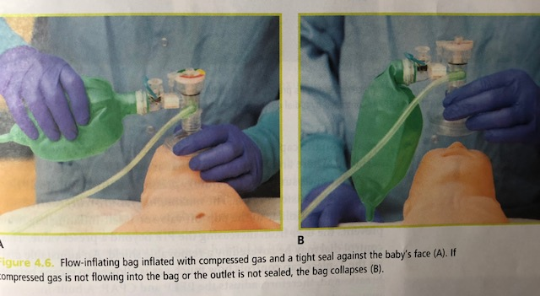
Flow Inflating Bag

Slide 9
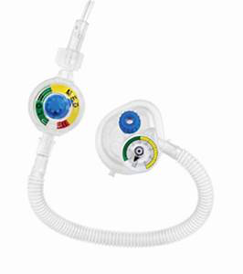
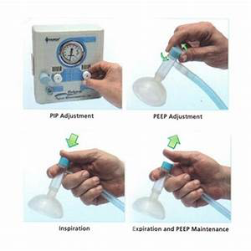
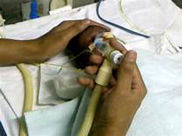
T-piece resuscitator

Slide 10
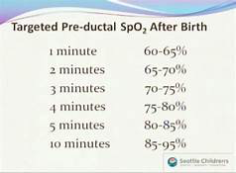
Indications for PPV
Apnea (not breathing)
Gasping
Heart rate < 100 beats per minute
O2 saturation
< the target range despite
free flow O2 or CPAP

Slide 11
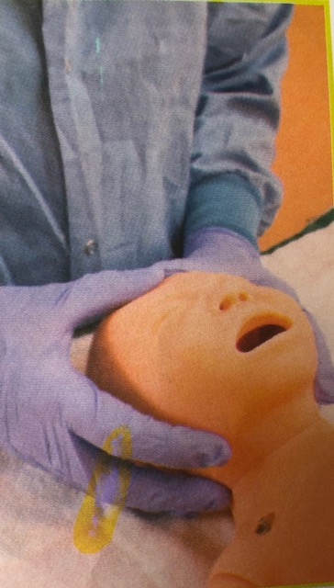
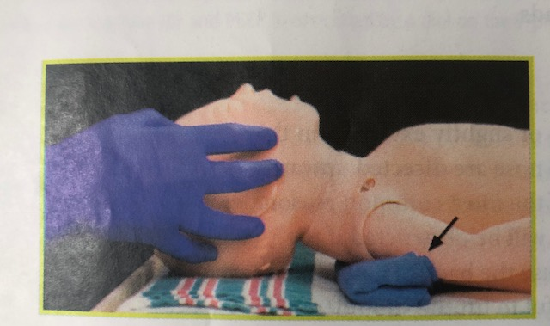
PPV preparations
Clear secretions from airway (mouth and nose)
Position yourself at baby’s head
Position the baby’s head and neck
Select the correct sized mask
Place the mask on the baby’s face
Select O2 concentration

Slide 12
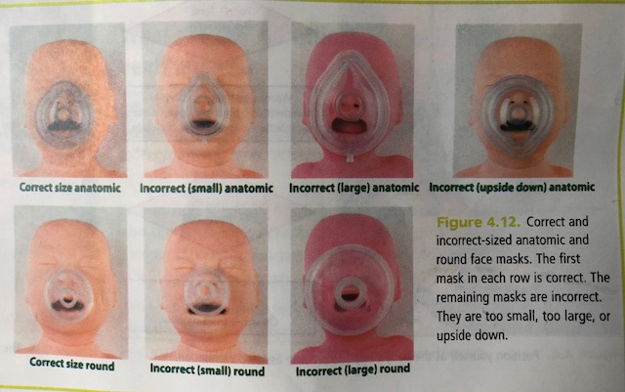

Slide 13
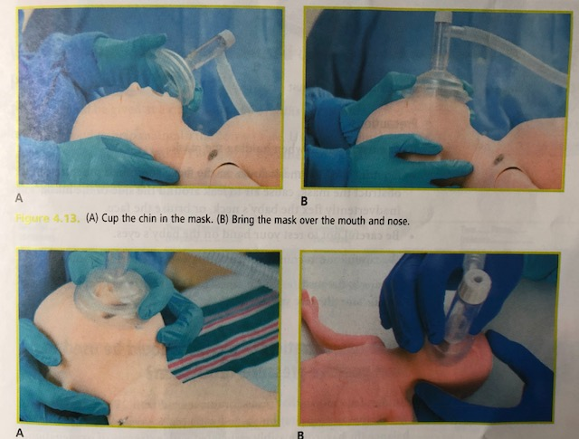

Slide 14
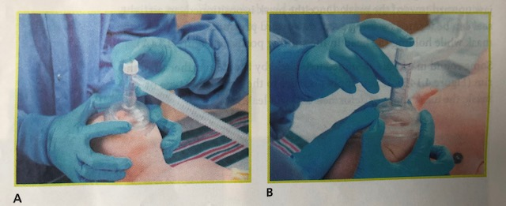

Slide 15
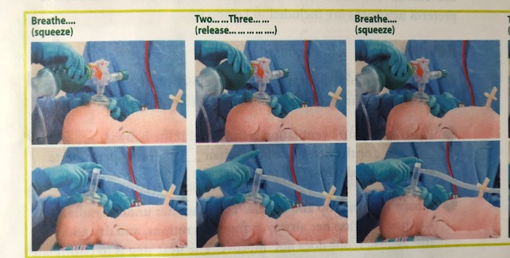
Ventilation Rate
40-60 breaths per minute

Slide 16
O2 Concentration
>35 weeks gestation, set blender to 21% O2
< 35 weeks gestation, set blender to 21-30% O2
Flowmeter to 10 L/minute
Adjust O2 concentration according to
pulse oximeter reading on baby’s
pre ductal saturation

Slide 17
Pressure used to start PPV
Start PIP at 20-25 cm H2O
Full term babies may requires 30-40 cm H2O
Decreases pressure after few breaths
Administer PEEP with initial inflating breaths, 5 cm H2O
Watch gentle rise and fall of chest
Beware of too much Pressure: PNEUMOTHORAX
Notes:
Fetal lung fluid within alveoli replaced with air for gas exchange. Pressure moves fluid out of air spaces and inflate the alveoli. Avoid too much pressure

Slide 18
Evaluate baby’s response after 15 sec of PPV
1- Heart rate is increasing
2- Heart rate is not increasing
A- Chest IS moving
Continue PPV, assess HR after another 15 sec
B- Chest IS NOT moving
Ventilation corrective steps:
MR. SOPA
If chest moves, continue PPV, assess HR after 15 sec

Slide 19
MR. SOPA
M = Mask adjustment R= Reposition airway Try PPV and reassess chest movement
S= Suction mouth and nose O= Open mouth Try PPV and reassess chest movement
P= Pressure increase Try PPV and reassess chest movement
A= Alternative Airway (endotracheal tube or laryngeal mask)

Slide 20
Check baby’s heart rate after 30 secs of correct ventilation
HR > 100 bpm
Continue PPV, monitor chest movement, HR, respiratory effort
Discontinue PPV when HR continuously > 100 bpm + spontaneous respirations

Slide 21
Check baby’s heart rate after 30 seconds of correct ventilation
HR> 60 bpm but < 100 bpm
Is chest moving? Breath sounds equal both lungs?
Adjust 02 concentrations to Fi02 to 100%
Consider alternative airway
HR < 60 bpm
Is chest moving? Breath sounds equal both lungs?
Adjust O2 concentration to Fi02 to 100%
Insert alternative airway and provide PPV x 30 secs
Chest Compressions

Slide 22
Baby breathing spontaneously, HR > 100 bpm, but labored breathing or Low 02 sat with free flowing 02
CPAP
Not appropriate if baby NOT breathing spontaneously or HR < 100 bpm
CPAP maintains pressure within lungs of a spontaneously breathing baby, keeps lungs inflated at all times (even end of exhalation)
Adjust PIP and PEEP
PEEP: pressure maintained between breaths when a baby is receiving assisted breaths
Notes:
Adjust PIP and PEEP before placing mask on baby’s face: hold mask tightly on hand,

Slide 23
CPAP
*CPAP during initial stabilization period
-Tight seal with mask of T-piece resuscitator or flow inflating bag
-CANNOT USE SELF INFLATING BAG
*CPAP after initial stabilization period
-Nasal prongs/mask
-Bubbling water system, dedicated CPAP device or mechanical ventilator

Slide 24
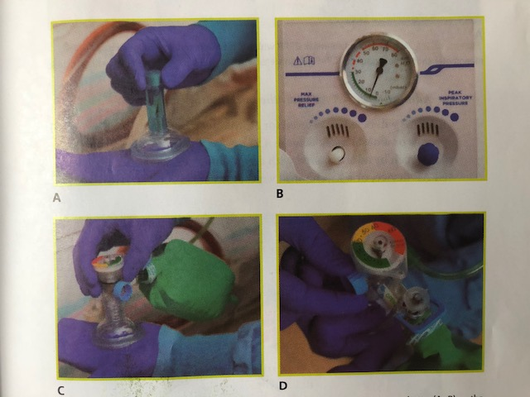

Slide 25
Orogastric Tube
During PPV with a mask, or CPAP
Equipment:
8F feeding tube
Large syringe 10 ml
Tape
Notes:
Gas enters esophagus and stomach, interferes with respiration

Slide 26
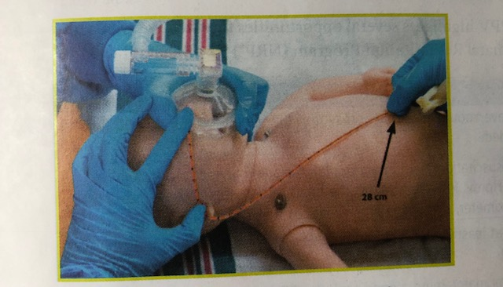
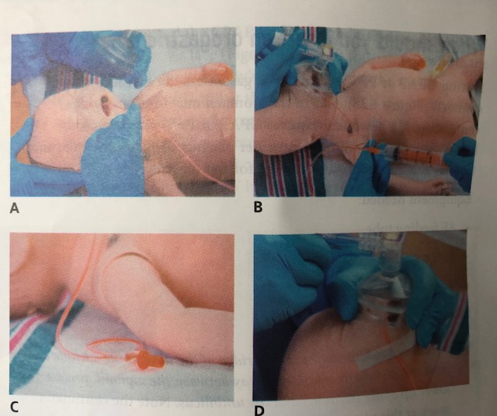
Notes:
Insertion:
Measure bridge of nose to earlobe and to point halfway between xiphoid process and umbilicus
Insert through mouth
Attach syringe, remove gastric contents
Remove syringe and leave end of tube open, tape tube to cheek
Continue ventilation

Slide 27
CO2 Detector
CO2 exhaled from lungs during effective ventilation
Place CO2 detector between mask and PPV device
CO2 detector will turns yellow during each exhalation if effective ventilation
If CO2 detectors stays blue/purple, you are not providing correct ventilation. Need alternative airway

Slide 28
Self inflating bags
Do not require compressed gas source
Cannot be used to administer free flow O2 thru mask
Cannot be used to administer CPAP to a spontaneously breathing baby

Slide 29
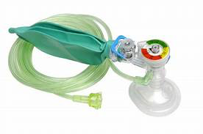
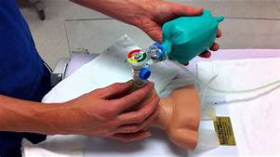
Flow inflating bags
Require compressed gas source
Must have a tight seal to inflate
Use a flow control valve to regulate the PIP and PEEP
Can be used to administer free flow O2 through the mask
Can be used to administer CPAP to a spontaneously breathing baby

Slide 30
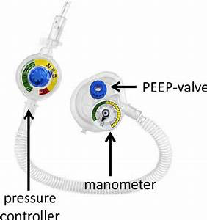
T-piece resuscitator
Require a compressed gas source
Use adjustable dials to select the PIP and PEEP
Can be used to administer free flow O2 through the mask
Can be used to administer CPAP to a spontaneously breathing baby

Slide 31
Case Scenario
Become familiar with available PPV equipment
Proceed to case

