Slide 1
Initial Steps of Newborn Care

Slide 2
Initial Steps of Newborn Care
Rapid Assessment of the NB
Initial Steps of NB Care
How to determine if additional steps required
What to do if baby has:
Persistent cyanosis/labored breathing
How to use a Pulse Oximeter
How to give supplemental O2
When to consider PPV
What to do when meconium stained amniotic fluid present

Slide 3
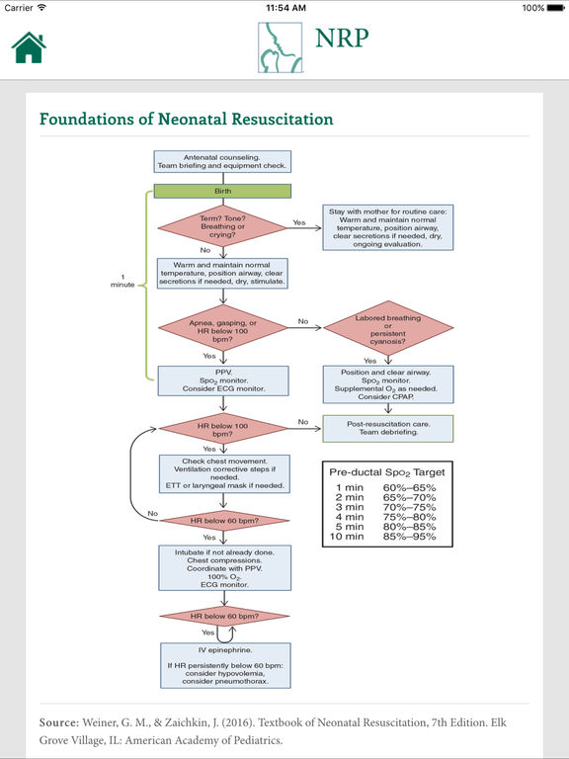

Slide 4
Case 1: Uncomplicated Birth
Healthy woman at 39wks
uncomplicated single pregnancy
Membranes rupture, amniotic fluid clear
RN assigned to baby checks equipment and supplies.
Baby born, FT, good muscle tone, crying
Positioned on mother skin to skin, covered with worm blanket and dried
RN stimulates her.
Cord clamped at 1 min. Color pink
Successful transition to NB circulation
Notes:
RN continues to evaluate resp effort, tone, color and thermoregulation. Shortly after birth, her mother positions her to initiate breastfeeding

Slide 5
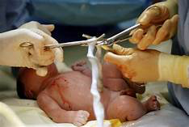
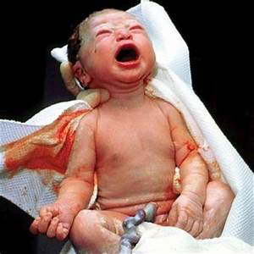

Slide 6
Case 2: Delayed Transition
Multiparous woman at 39wks, active labor and ruptured membranes.
After admission mother develops fever, and given antibiotics
Fetal HR monitoring: Category II
NN resuscitation team called
Introduce team
4 pre birth questions for risk factors
Re resuscitation team briefing
Equipment check

Slide 7
Case 2: Delayed Transition
Baby born
Poor tone, no cry. OB holds in warm blanket, suctions mouth and nose, stimulates, no change in status, cord cut
Brought to radiant warmer
Position/open airway, stimulate. Tone and respiratory effort improves. HR 120bpm and good BS
5 min
Central cyanosis and Pulse Ox on right hand < minute specific value, so given supplemental O2
10 min
Breathing regularly, Pulse Ox in normal range, O2 stopped
Placed skin to skin on mother and monitored
Team conducts short debriefing: preparation, team work, communication

Slide 8
Time of birth and clamping the umbilical cord
Evidence supports clamping at 30-60 sec for most vigorous term and preterm NB
If placental circulation not intact, cord should be clamped immediately
Notes:
Subject of ongoing research
Placenta previa, bleeding vasa previa, cord avulsion
Potential adverse effects of delayed clamping : delayed resuscitation, increased risk of polycythemia, jaundice
Not enough evidence to make definitive recommendations in delayed cord clamping in non vigorous newborns

Slide 9
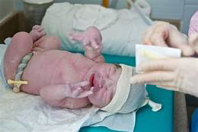
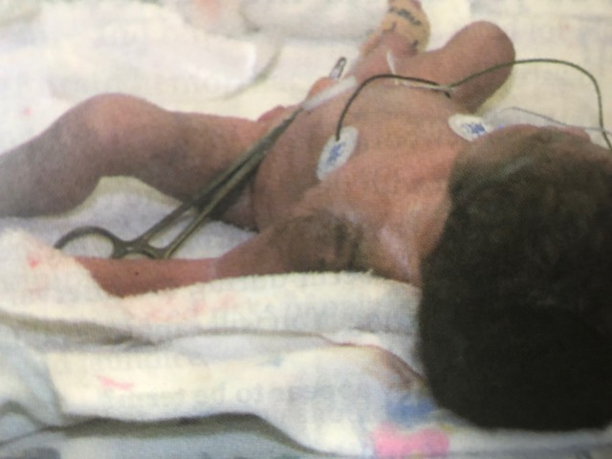
All newborns need rapid evaluation
1- Term?
2- Good muscle tone?
3- Is baby breathing or crying?
Notes:
Before cord clamping.
If baby appears pre term < 37 wks, bring to radian warmer for the initial steps, more likely to require interventions during transition: expanding lungs, establishing good respiratory effort, maintaining body T
if term initial steps with mother to continue transition

Slide 10
Initial Steps for Newborn Care
Provide warmth
Position head and neck
Clear secretions, if needed
Dry
Stimulate

Slide 12
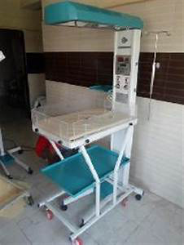
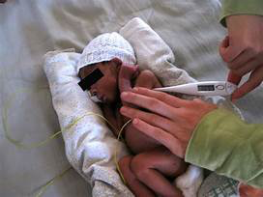
Provide warmth

Slide 13
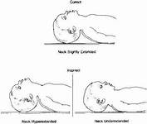
Position head and neck to open airway

Slide 14
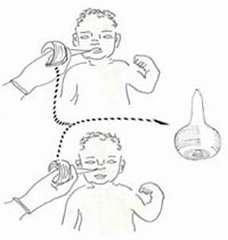
Clear secretions from the airway
Notes:
If baby not breathing, is gasping, has poor tone, if secretions are obstruction the airway, if baby having difficulty clearing their secretions, if there is meconium stained fluid,or if you are starting PPV
Mouth (M) before Nose (N)

Slide 15
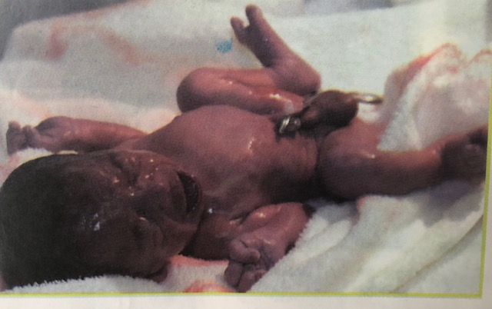
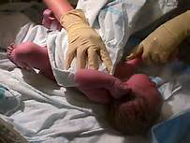
Dry

Slide 16
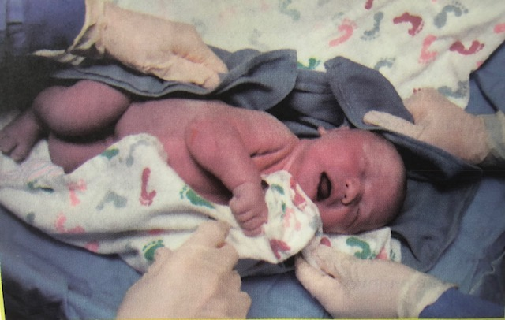
Stimulate

Slide 17
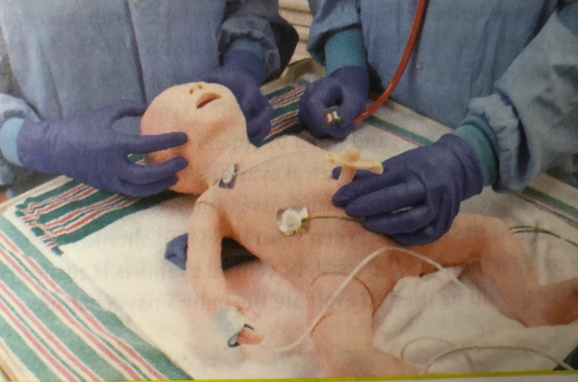
Assess newborn’s response to initial steps
Respirations
If not breathing, or is gasping, proceed to Positive Pressure Ventilation
Heart rate
100 bpm
Stethoscope
Count number beats in 6 sec, multiply by 10
Connect pulse oximeter to right hand, ECG monitor
If HR < 100 Start Positive Pressure Ventilation (PPV)

Slide 18
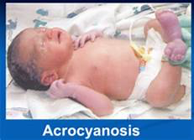
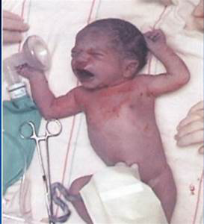
If baby breathing and HR> 100, but cyanotic: give Oxygen
Cyanosis
Poorly oxygenated blood
Acrocyanosis
Central cyanosis
Pulse oximetry
Measures Hbg saturated with Oxygen
Takes 10 min for newborn to reach normal levels
Notes:
Hgb saturated with O2 absorbs red light differently than hgb that is not carrying O2. pulse ox uses light source and sensor to measure absorption of red light passing thru cap and estimates portion hgb that is fully saturated with o2. also displays heart rate

Slide 19
Pulse Oximetry
When resuscitation
Confirm central cyanosis
When giving supplemental O2
When giving PPV
Pre ductal: right wrist/hand
Artery to right arm attaches to aorta before the ductus arteriosus
Values change after birth

Slide 20
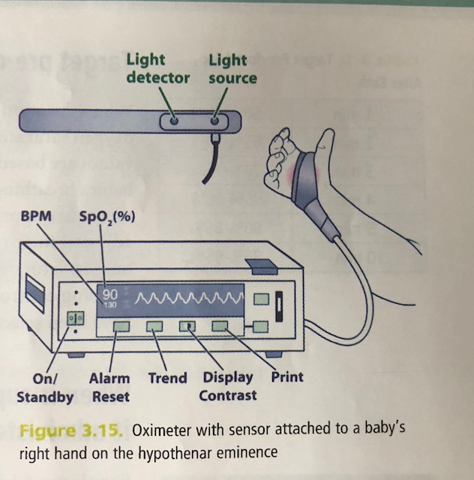
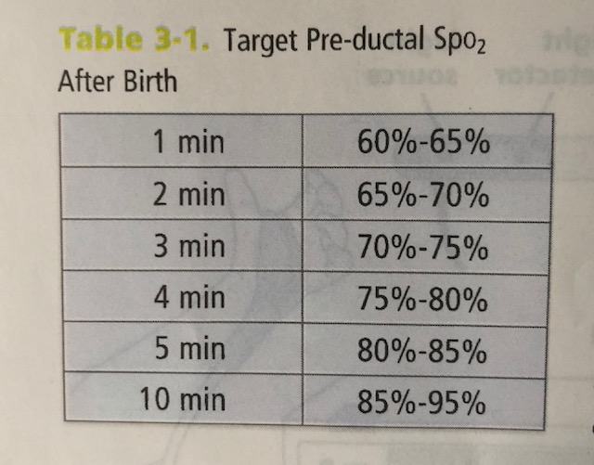
Pulse Oximetry

Slide 21
When is supplemental O2 given?
Oximeter reading is < target range for baby’s age in minutes
If baby spontaneously breathing
Free flowing oxygen
O2 tubing
O2 mask
Flow inflating bag and mask
T-piece resuscitator and mask
Open reservoir on self inflating bag
If baby not breathing or gasping
PPV

Slide 22
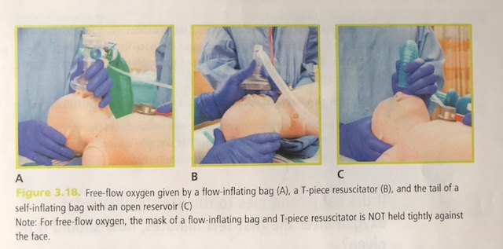
Free Flowing O2

Slide 23
Adjusting O2 Concentration
Goal
Maintain baby’s minute specific O2 saturation
Prevent hypoxia and hyperoxia
Adjust delivered O2 using
Compressed air and O2
Oxygen blender (21-30%)
Flowmeter (adjust to 10L/min)

Slide 24
What if baby has labored breathing or persistently low O2 saturation?
CPAP: continuous positive airway pressure
Continuous low gas pressure to keep a spontaneously breathing baby’s lungs open
Baby must be breathing and have HR > 100bpm
Flow inflating bag
T-piece resuscitator with mask
Both tightly fitted to baby’s face

Slide 25
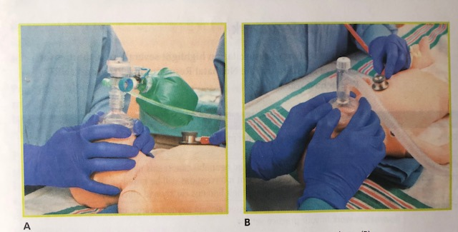
CPAP

Slide 26
Meconimum stained amniotic fluid
Vigorous Newborn
Good respiratory effort and muscle tone
Stay with mother, initial steps
Gently bulb suction mouth and nose
Non-vigorous Newborn
Bring to radiant warmer for initial steps
Bulb suction mouth and nose
If baby not breathing, or HR < 100bpm after initial steps, proceed to PPV

Slide 27
Case Scenario
You are called to attend a vaginal birth. The mother is in active labor with ruptured membranes.
How would you prepare for this baby?

