Slide 1
NeoNatal Resuscitation
Ramona Sunderwirth, MD
Pediatrics Emergency Medicine
Mt Sinai St Luke’s Hospital Medical Center
New York, NY

Slide 2
Neo Natal Resuscitation Course
Foundations
Preparing for Resuscitation
Initial Steps of Newborn Care
Positive Pressure Ventilation
Alternative Airways: endotracheal tubes and Laryngeal masks
Chest Compressions
Medications
Post resuscitation Care
Resuscitation /Stabilization of Preterm babies
Special considerations
Skills Practice
Case scenarios

Slide 3
Foundations of NN Resuscitation
Why NN resuscitation skills are important
Physiologic changes that occur during and after birth
Format of the Neonatal Resuscitation Program Flow Diagram
Communication and teamwork skills used by effective resuscitation teams
Notes:
Most nn make the cardio respiratory transition extra uterine life without intervention, many will require assistance to begin breathing and a small number will require ext3nsive intervention.
After birth, 4-10% of term and late preterm nn will receive PPV, only 1-3/1,1000 will receive chest compressions or emergency medications.
The need for assistance cannot always be predicted, teams need to be prepared to provide lifesaving interventions quickly and efficiently at every birth

Slide 4
Why do newborns require a different approach to resuscitation than adults?
Adults requiring resuscitation
Trauma
Existing heart disease
CAB (Circulation, Airway, Breathing)
Notes:
Sudden event preventing heart from circulating blood/O2. Pt loses consciousness and stops breathing, O2 and CO2 content of blood usually normal. So Chest Compressions are 1st part of adult resuscitation to maintain circulation till defibrillation or medications restore cardiac function CAB

Slide 5
Why do newborns require a different approach to resuscitation than adults?
Newborns requiring resuscitation
Respiratory problems leading to inadequate gas exchange
Respiratory failure
ABC (Airway, Breathing, Circulation)

Slide 6
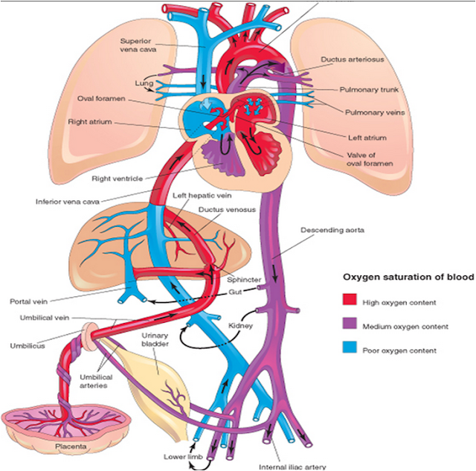
Fetal Circulation
Notes:
Before birth: fetal respiratory function performed by the placenta. O2 is transferred from the mother to the fetus, and CO2 is removed. When placental resp fails, fetus receives insufficient O2 to support normal cellular functions and CO2 not removed

Slide 7
NeoNatal Respiratory Failure
Before Birth
Early and late stages of respiratory failure
After Birth
Early or late?
Baby does not initiate of cannot maintain effective breathing effort
Notes:
When placental resp fails, fetus receives insufficient O2 to support normal cellular functions and CO2 not removed. Fetal monitoring show decrease in activity, loss of HR variability, HR decelrations. If placental resp failure persists, fetus with make a series of gasps, then apnea and bradycardia. Early phase of resp failure: tactile stimulation may be sufficient to initiate spontaneous breahthng and recovery. Later phases of resp failure require assisted ventilation. The most severely affected NN: chest compressions and epi

Slide 8
NeoNatal Resuscitation Focus
Establishing effective VENTILATION
Single MOST IMPORTANT concept

Slide 9
What happens during the transition from fetal to neonatal circulation?
The baby is born, breathes, cord clamped
Baby now uses lungs, not the placenta, for gas exchange
Fluid in the lungs is absorbed
Air replaces fluid in alveoli,
O2 moves from alveoli into pulmonary blood vessels
CO2 moves into alveoli and is exhaled
Air in alveoli causes blood vessels in the lung to dilate
Pulmonary blood flood increases
Ductus arteriosis constricts
Notes:
Baby now separated from placenta

Slide 10
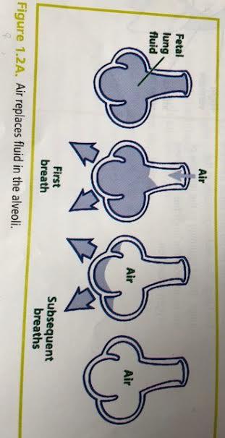
Baby’s cries move fluid out of alveoli

Slide 11
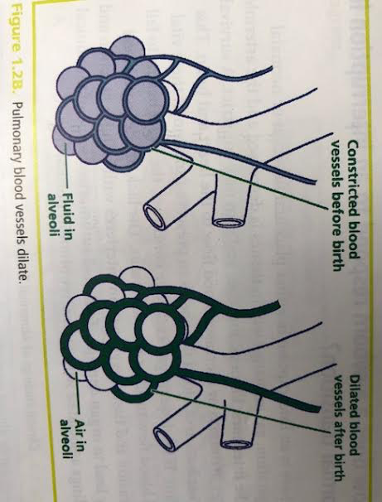
Pulmonary Vessels dilate

Slide 12
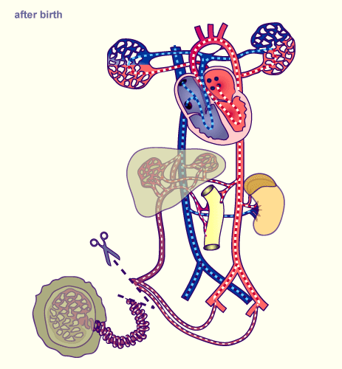
New Born Circulation
Notes:
Initial steps in transition take few minutes after birth, entire process may take hours to several days. It takes 10 min for and normal NN to achieve O2 sats >90%

Slide 13
Review
Before birth, the alveoli in the fetal lungs are expanded and filled with (fluid)/(air)
Before birth, O2 is supplied to the fetus by the (the placenta)/(the fetal lungs)
After birth, air in the alveoli causes vessels in the baby’s lungs to (constrict)/(relax)

Slide 14
Answers
Before birth, the alveoli in the fetal lungs are expanded and filled with (fluid)/(air)
Before birth, O2 is supplied to the fetus by the (the placenta)/(the fetal lungs).
After birth, air in the alveoli causes vessels in the baby’s lungs to (constrict)/(relax)

Slide 15
How does newborn respond to an interruption in normal transition?
Irregular, or rapid breathing or apnea
Slow heart rate or rapid heart rate
Decreased muscle tone
Low oxygen saturation
Notes:
If interruption in placental function or nn respiration, gas exchange w/in tissues is decreased and arterioles in the organs constrict. Survival reflex maintains or increases blood flow to the heart and brain. If inadequate gas exchange continues, heart begins to fail and blood flow to all organs decreases. Lack of adequate blood perfusion and tissue oxygenation interferes with cellular function and leads to organ damage.

Slide 16
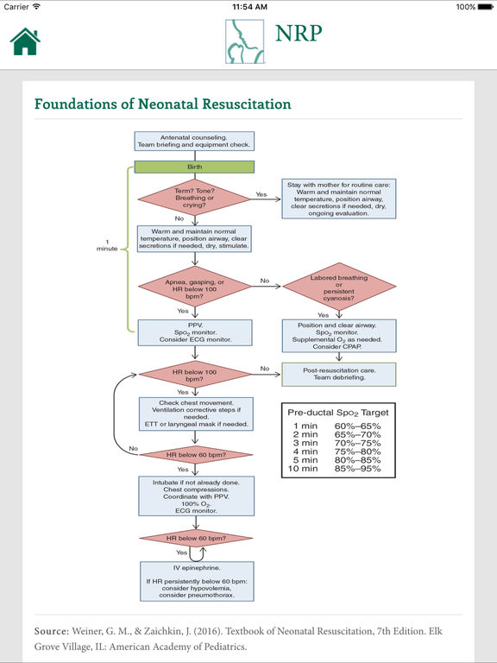

Slide 17
Communication and Team Work

Slide 18
Communication and Teamwork
Focus on teamwork
Poor teamwork and communication are causes for preventable infant deaths in the delivery room
During complex resuscitation, providers need to perform multiple procedures without delay

Slide 19
Pre resuscitation team briefing
Each team member need to understand roles and tasks
Before each birth, review the clinical situation and action plan
Assess perinatal risk factors, identify team leader, delegate tasks, determine what supplies and equipment needed, identify how to call for additional help
Notes:
Like airline pilots

Slide 20
The Team Leader
Good communication skills
Situational awareness: aware of the “big picture”
If team member changes during resuscitation, a clear verbal statement made so all team members know who team member is
Notes:
If involved in a procedure, another person should take over team member role
Skills: giving clear directions to specific individuals, sharing information, delegating responsibilities to ensure coordinated care and maintaining a professional environment
Allows all team members to contribute their talents

Slide 21
Effective communication
Every team member shares responsibility for resuscitation
Share information and communicate with each other

Slide 22
Closed Loop Communication Technique
Ensures instructions are heard and understood
When you give an instruction, direct the request to a specific individual, call them by their name, make eye contact and speak clearly
After giving instruction, ask the receiver to report back as soon as the tack is completed
After receiving an instruction, repeat the instruction back to the sender.
Notes:
Vi: Pom, I need a 3.5mm endotracheal tube, with a stylet, and a laryngoscope with a size 1 blade. Tell me when they’re ready
Pom: you want a 3/5 mm endotracheal tube, with a stylet and a laryngoscope with a size 1 blade
Vi: correct
Pom: Vi, a 3/5mm endotracheal tube, with a stylet and size 1 laryngoscope are ready now

Slide 23
Team Members
Leader
Airway
Chest compressions
Umbilical Vein/Intraosseous/IV access
Recording/Documentation
Medications

Slide 24
Post resuscitation team debriefing
Reinforces good teamwork habits, identifies areas for improvement
May identify major problems or small changes that results in improvements in team performance

Slide 25
NN Key Behavioral Skills - 10
1 – Know your environment
Perform equipment check before baby delivered
Know the location of resuscitation equipment
Know how to call for help and who is available

Slide 26
Behavioral Skills cont
2 – Use available information
Know the prenatal and intrapartum history
3 – Anticipate and plan
Pre resuscitation team briefing
Assign roles and responsibilities
Discuss an action plan in the event of complications
Notes:
(maternal complications, maternal medications, risk factors)

Slide 27
Behavioral Skills - cont
4 – clearly identify a team leader
Identify the team leader before the birth
Effective leaders
Notes:
States goals Delegate tasks Include other team members in assessment and planning Think “out loud”
Maintain situational awareness Hand over leadership to another team member if he/she must become involved in a procedure

Slide 28
Behavioral skills - cont
5 – Communicate effectively
Call team members by name
Share information actively
Inform your team if you identify a problem
Order medications by name, dose, and route
Use concise, clear language
Use closed-loop communication
Ensure that changes in information/assessments are shared
Include family members in communication as appropriate

Slide 29
Behavioral Skills - cont
6 – Delegate workload
Do not allow on person to become overloaded with tasks
7 - Allocate attention wisely
Maintain situational awareness
Notes:
6 - Do not allow on person to become overloaded with tasks
Do not allow the team to become fixated on a single task
7 -Maintain situational awareness by scanning and reassessing the clinical situation frequently
Monitor each other’s skill performance to ensure patient safety

Slide 30
Behavioral Skills - cont
8 – Use available resources
Know what personnel are available
Know what additional or special supplies are available/how to assess them
9 – Call for additional help when needed
Anticipate need for additional team members

Slide 31
Behavioral Skills - last
10 – Maintain professional behavior
Use respectful verbal and nonverbal communication
Seek and offer assistance
Support and promote teamwork
Respect and value your team

Slide 32
Key Points
Some NB require resuscitation, including assisted ventilation
NB resuscitation is usually the result of respiratory failure, either before or after birth
The most important and effective action in NB resuscitation is to VENTILATE the baby’s lungs
Very few NB require chest compressions or medications
Resuscitation should proceed quickly, efficiently
Teamwork, leadership, communication: critical to success

